Slide 1



Machine learning techniques for high-throughout analyses of TR-PES measurements
Convolutional Neural Networks employed to fit XPS spectra
Arthur Julien, Romaric Sallustre, Jean-Baptiste Puel, Philip Schulz

Slide 2

CTF1
Results from two measurements on CTF1:
20211125_TR CTF1 Pb 10 mW_0001_2: two examples of treatments with different smoothing intensity
20211125_TR CTF1 I3d 10 mW_0001_2: one example of treatment

Slide 3
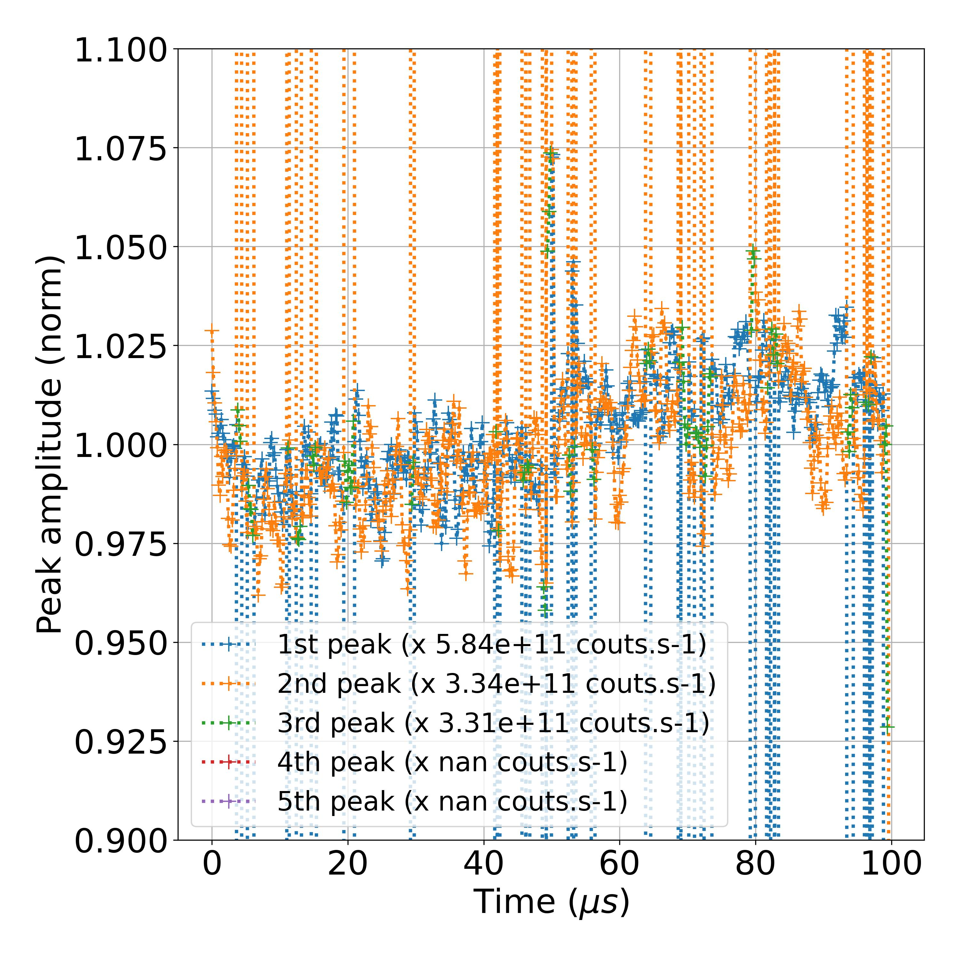
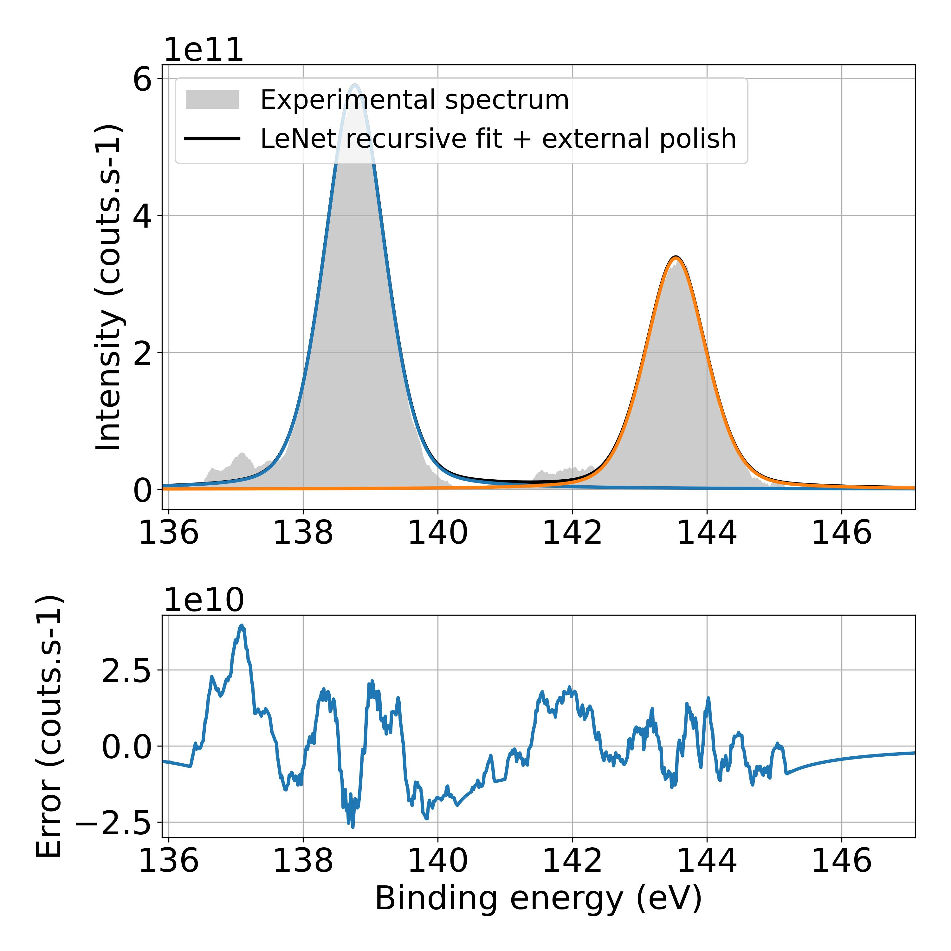
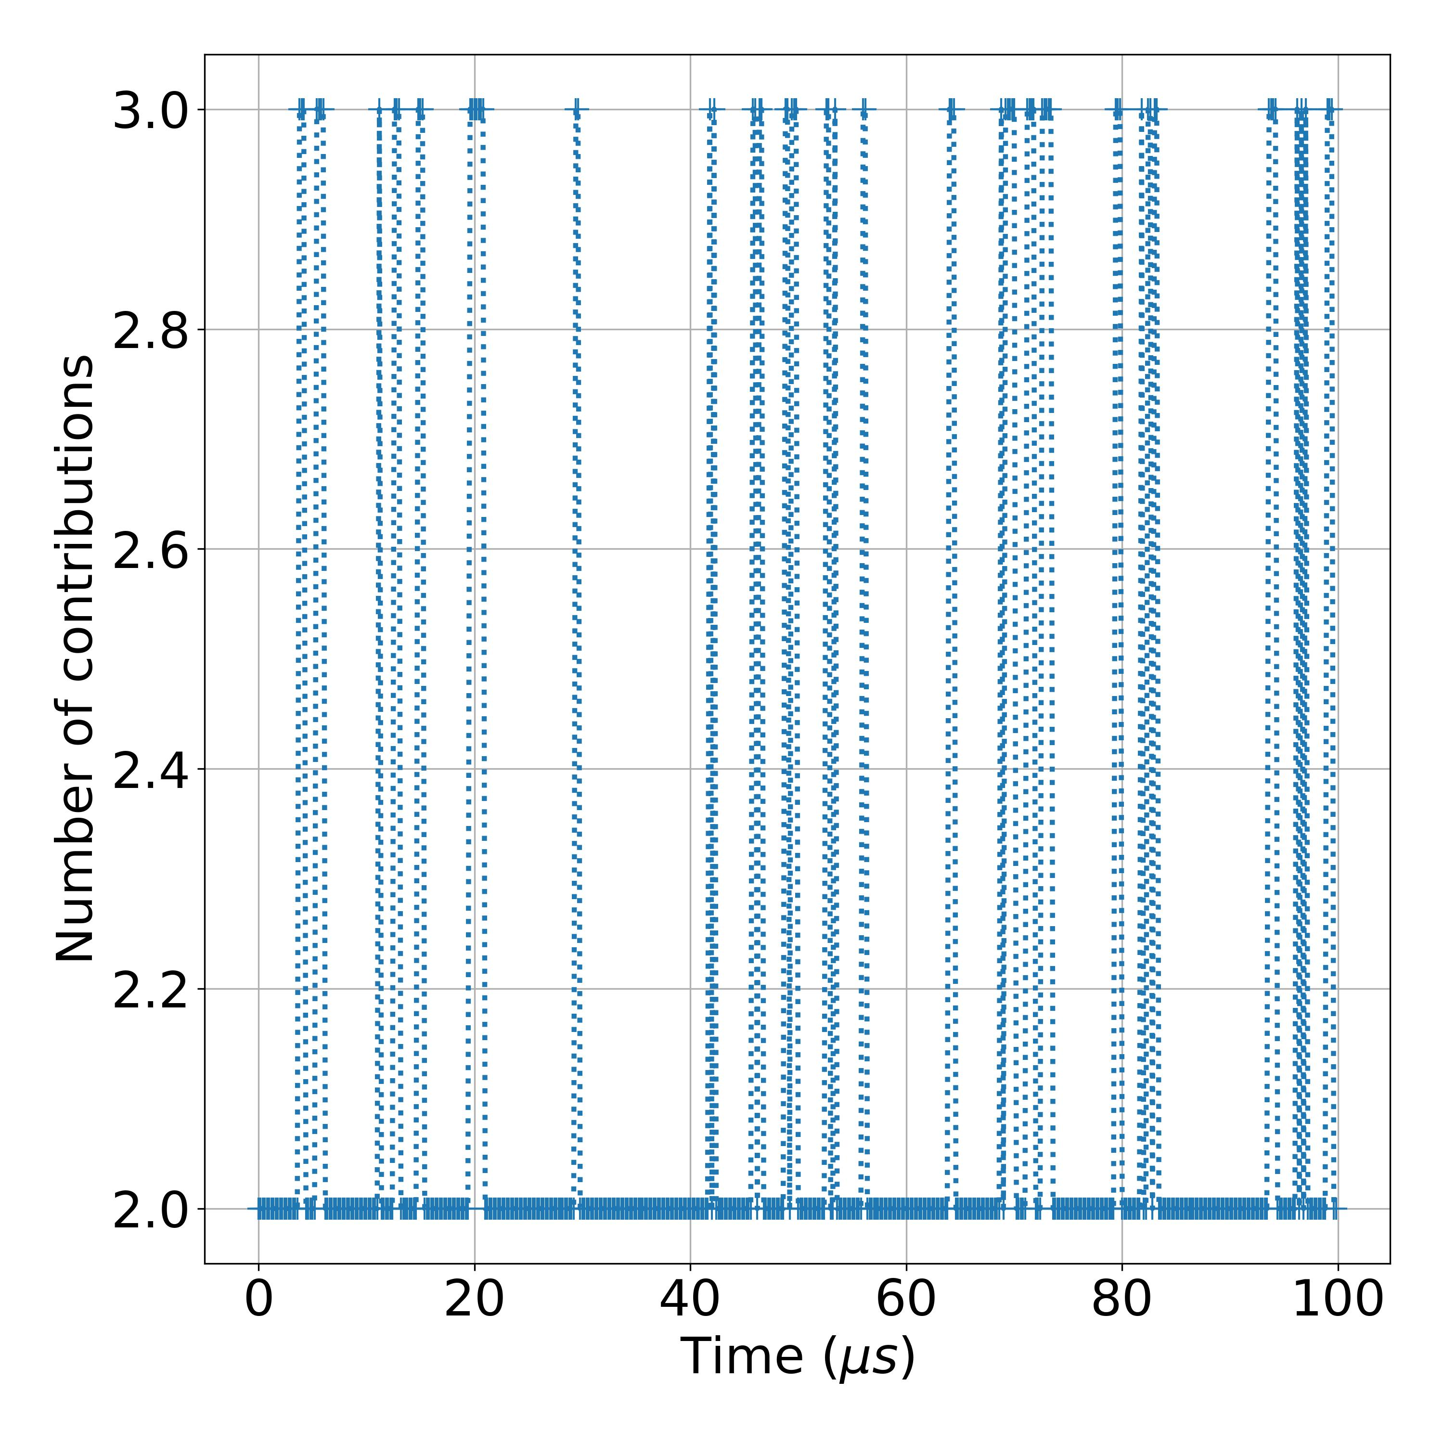
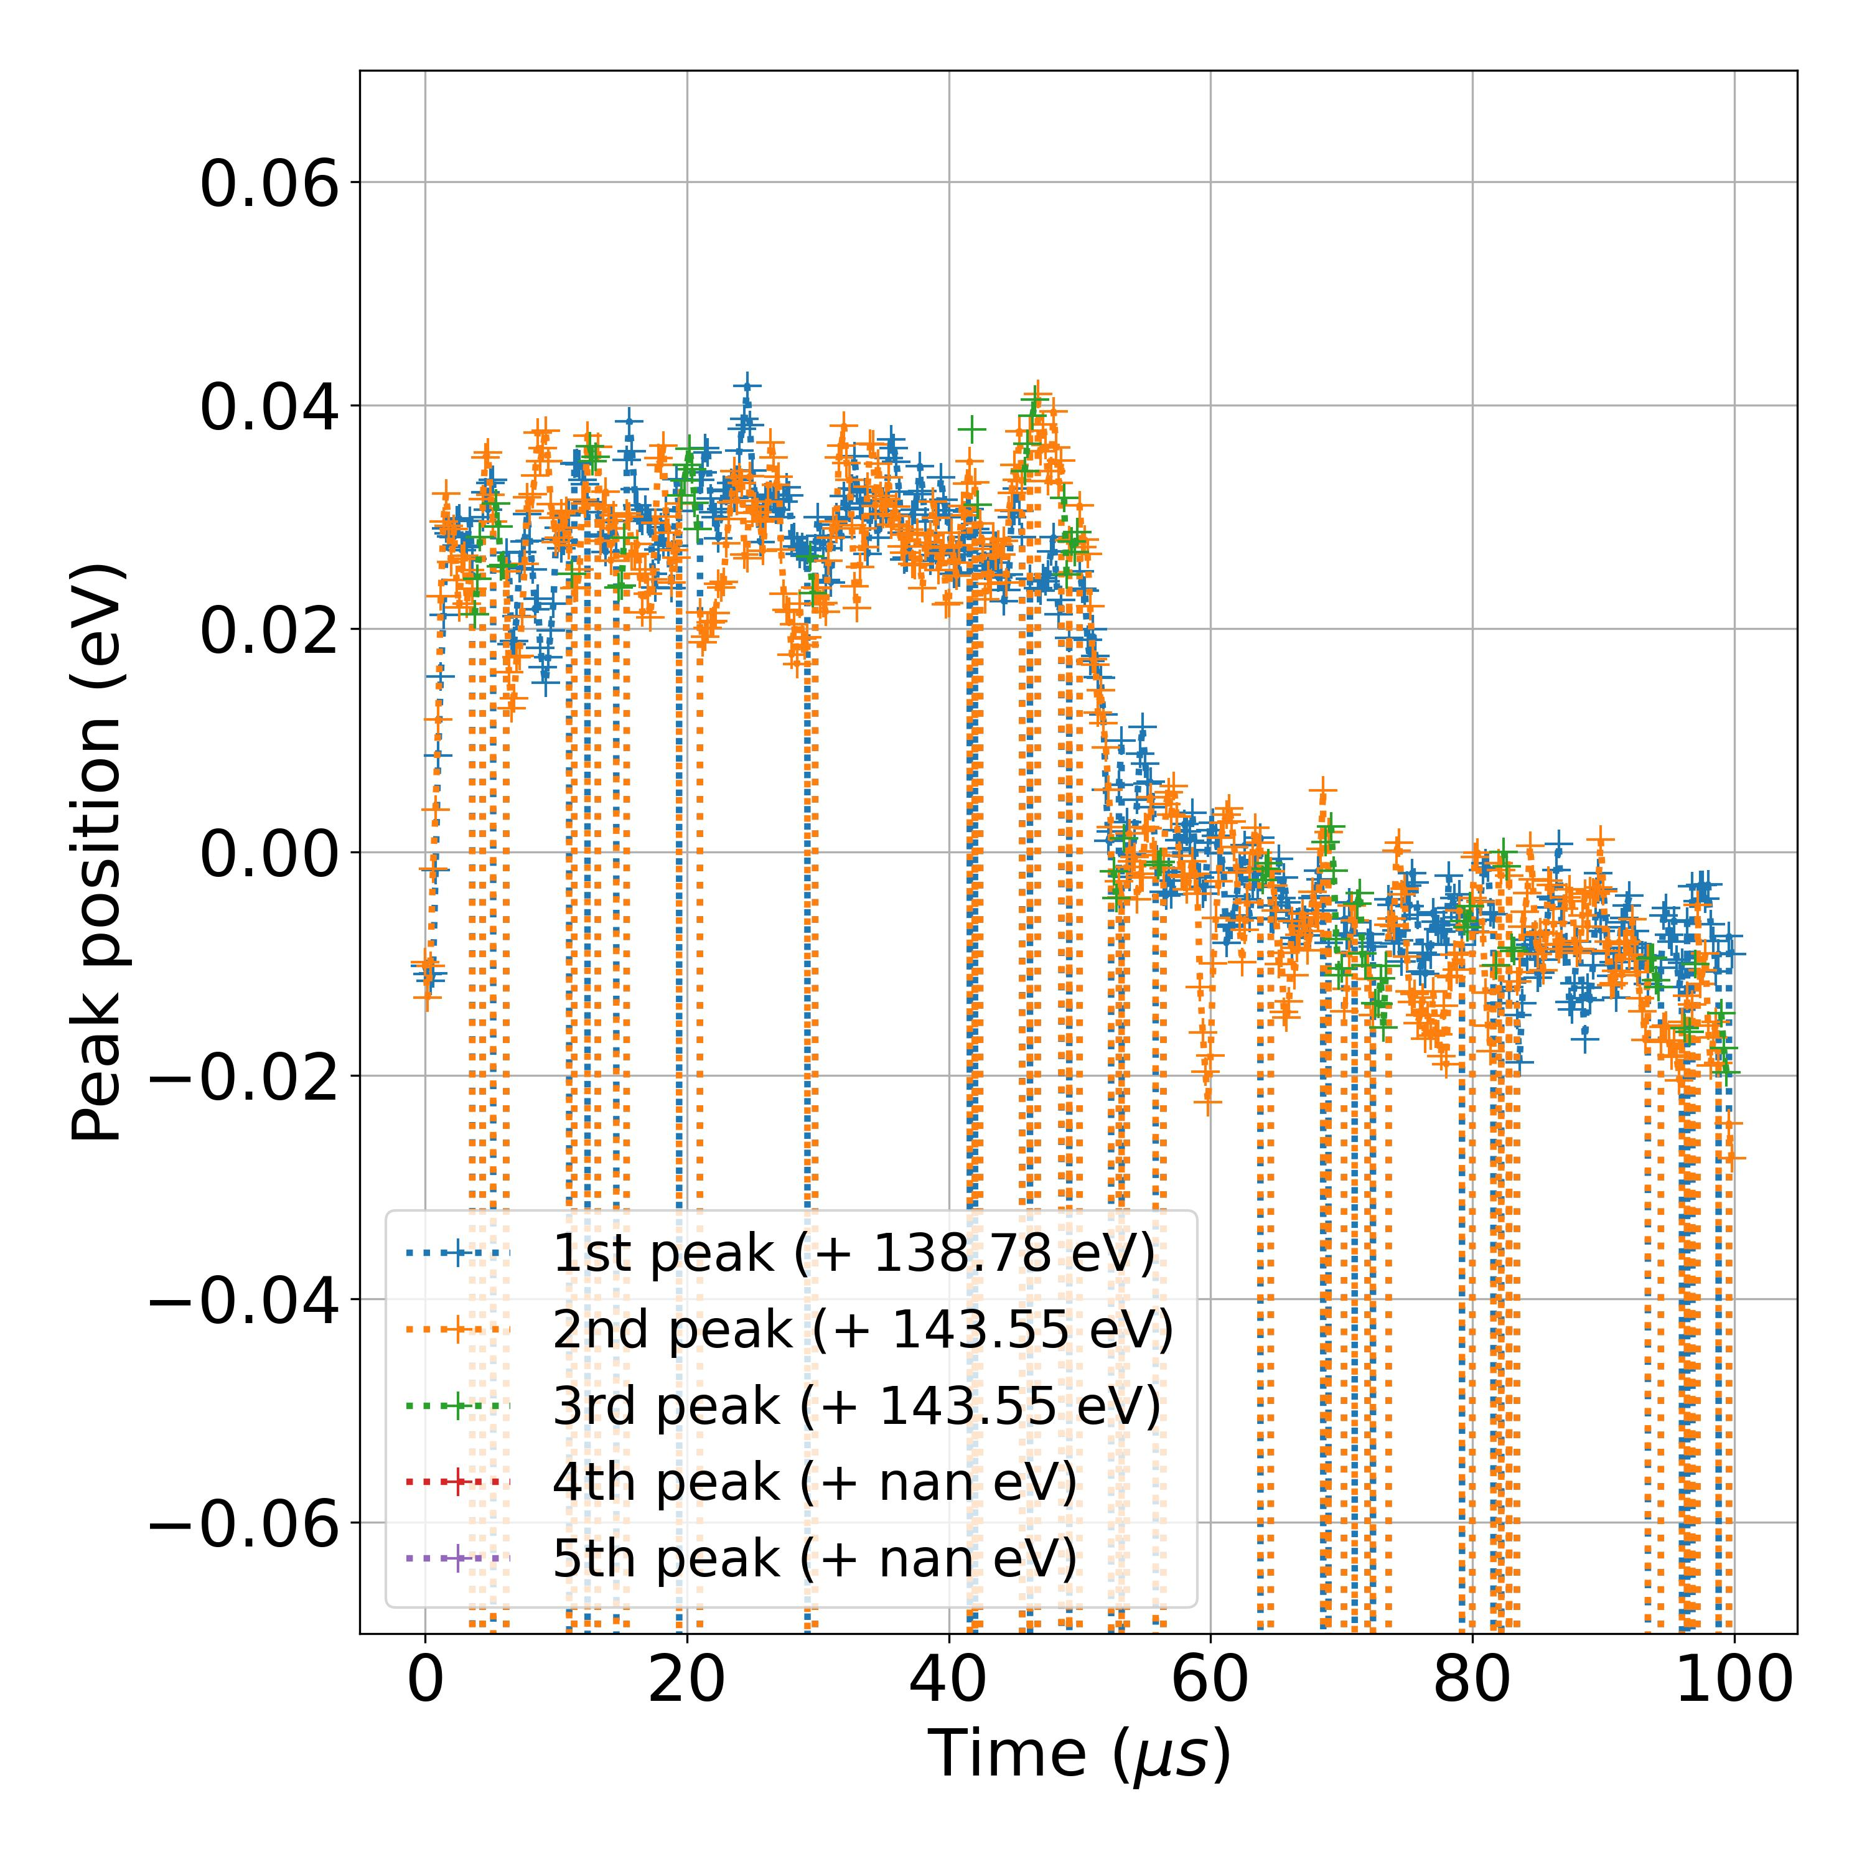
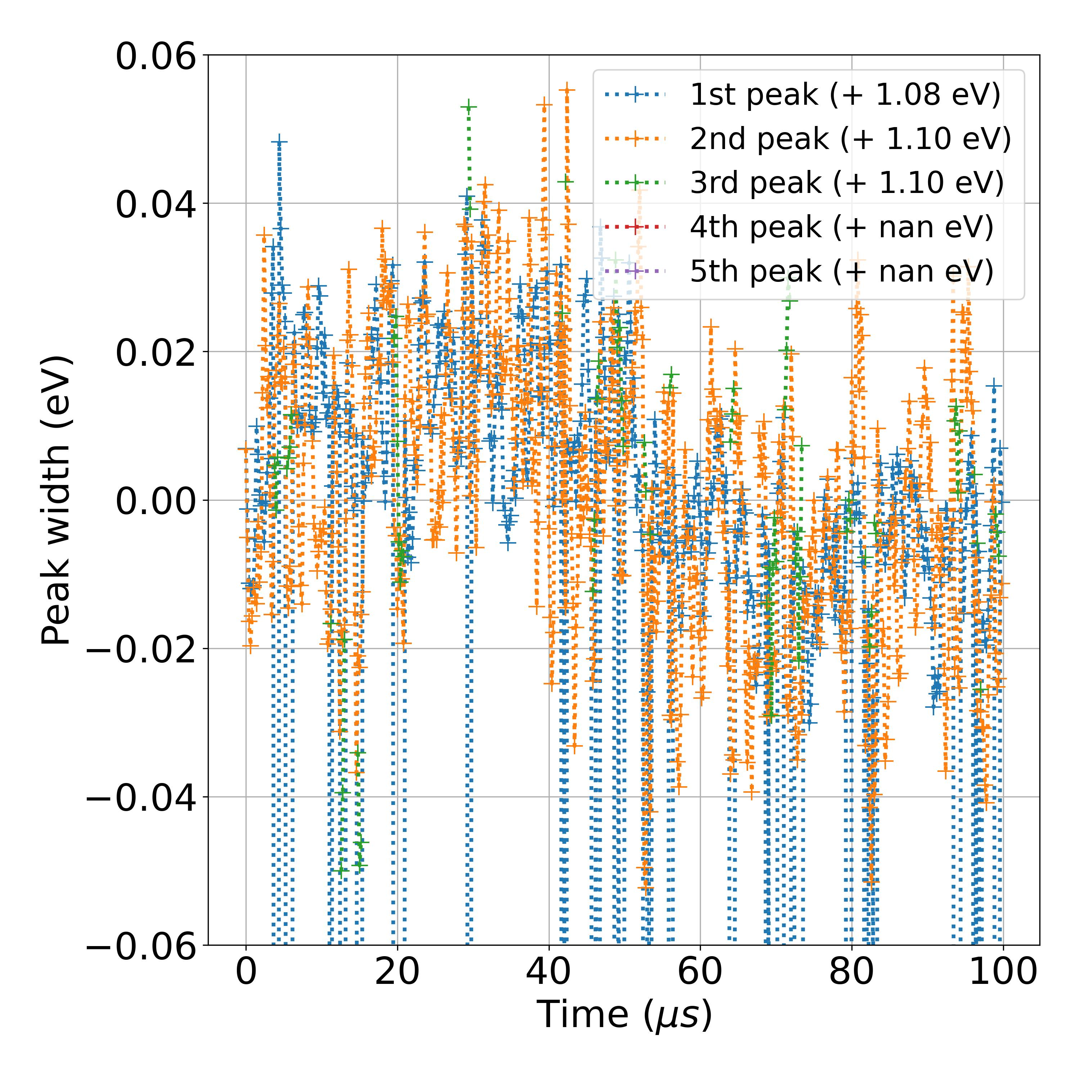
20211125_TR CTF1 Pb 10 mW_0001_2
Measurement number | Measurement Session | Sample | Input power | Core level | File | Comment | Matrix orientiation | Photon energy (eV) | Kinetic energy center (eV) | Energy resolution (eV) | Time resolution (ns) | Studied energy range (indexes) | Time agregation number | Time moving average window (us) | Energy Savitzky-Golay window (meV) | Energy Savitzky-Golay order | Pb 4f 7/2 background range (eV) | Pb 4f 5/2 background range (eV) | I 3d 5/2 background range (eV) | ML training session | ML model | Number of peaks
2 | November 2021 | CTF1 | 10 mW | Pb 4f | 20211125_TR CTF1 Pb 10 mW_0001_2 |  | (E,time) | 750 | 608.5 | 0.016 | 100 | [350,1050] | 2 | 0.5 | 300 | 3 | [136,140.5] | [140.5,145.5] |  | ML_models_large_database_noisy_v1 | LeNet | Auto

Slide 4
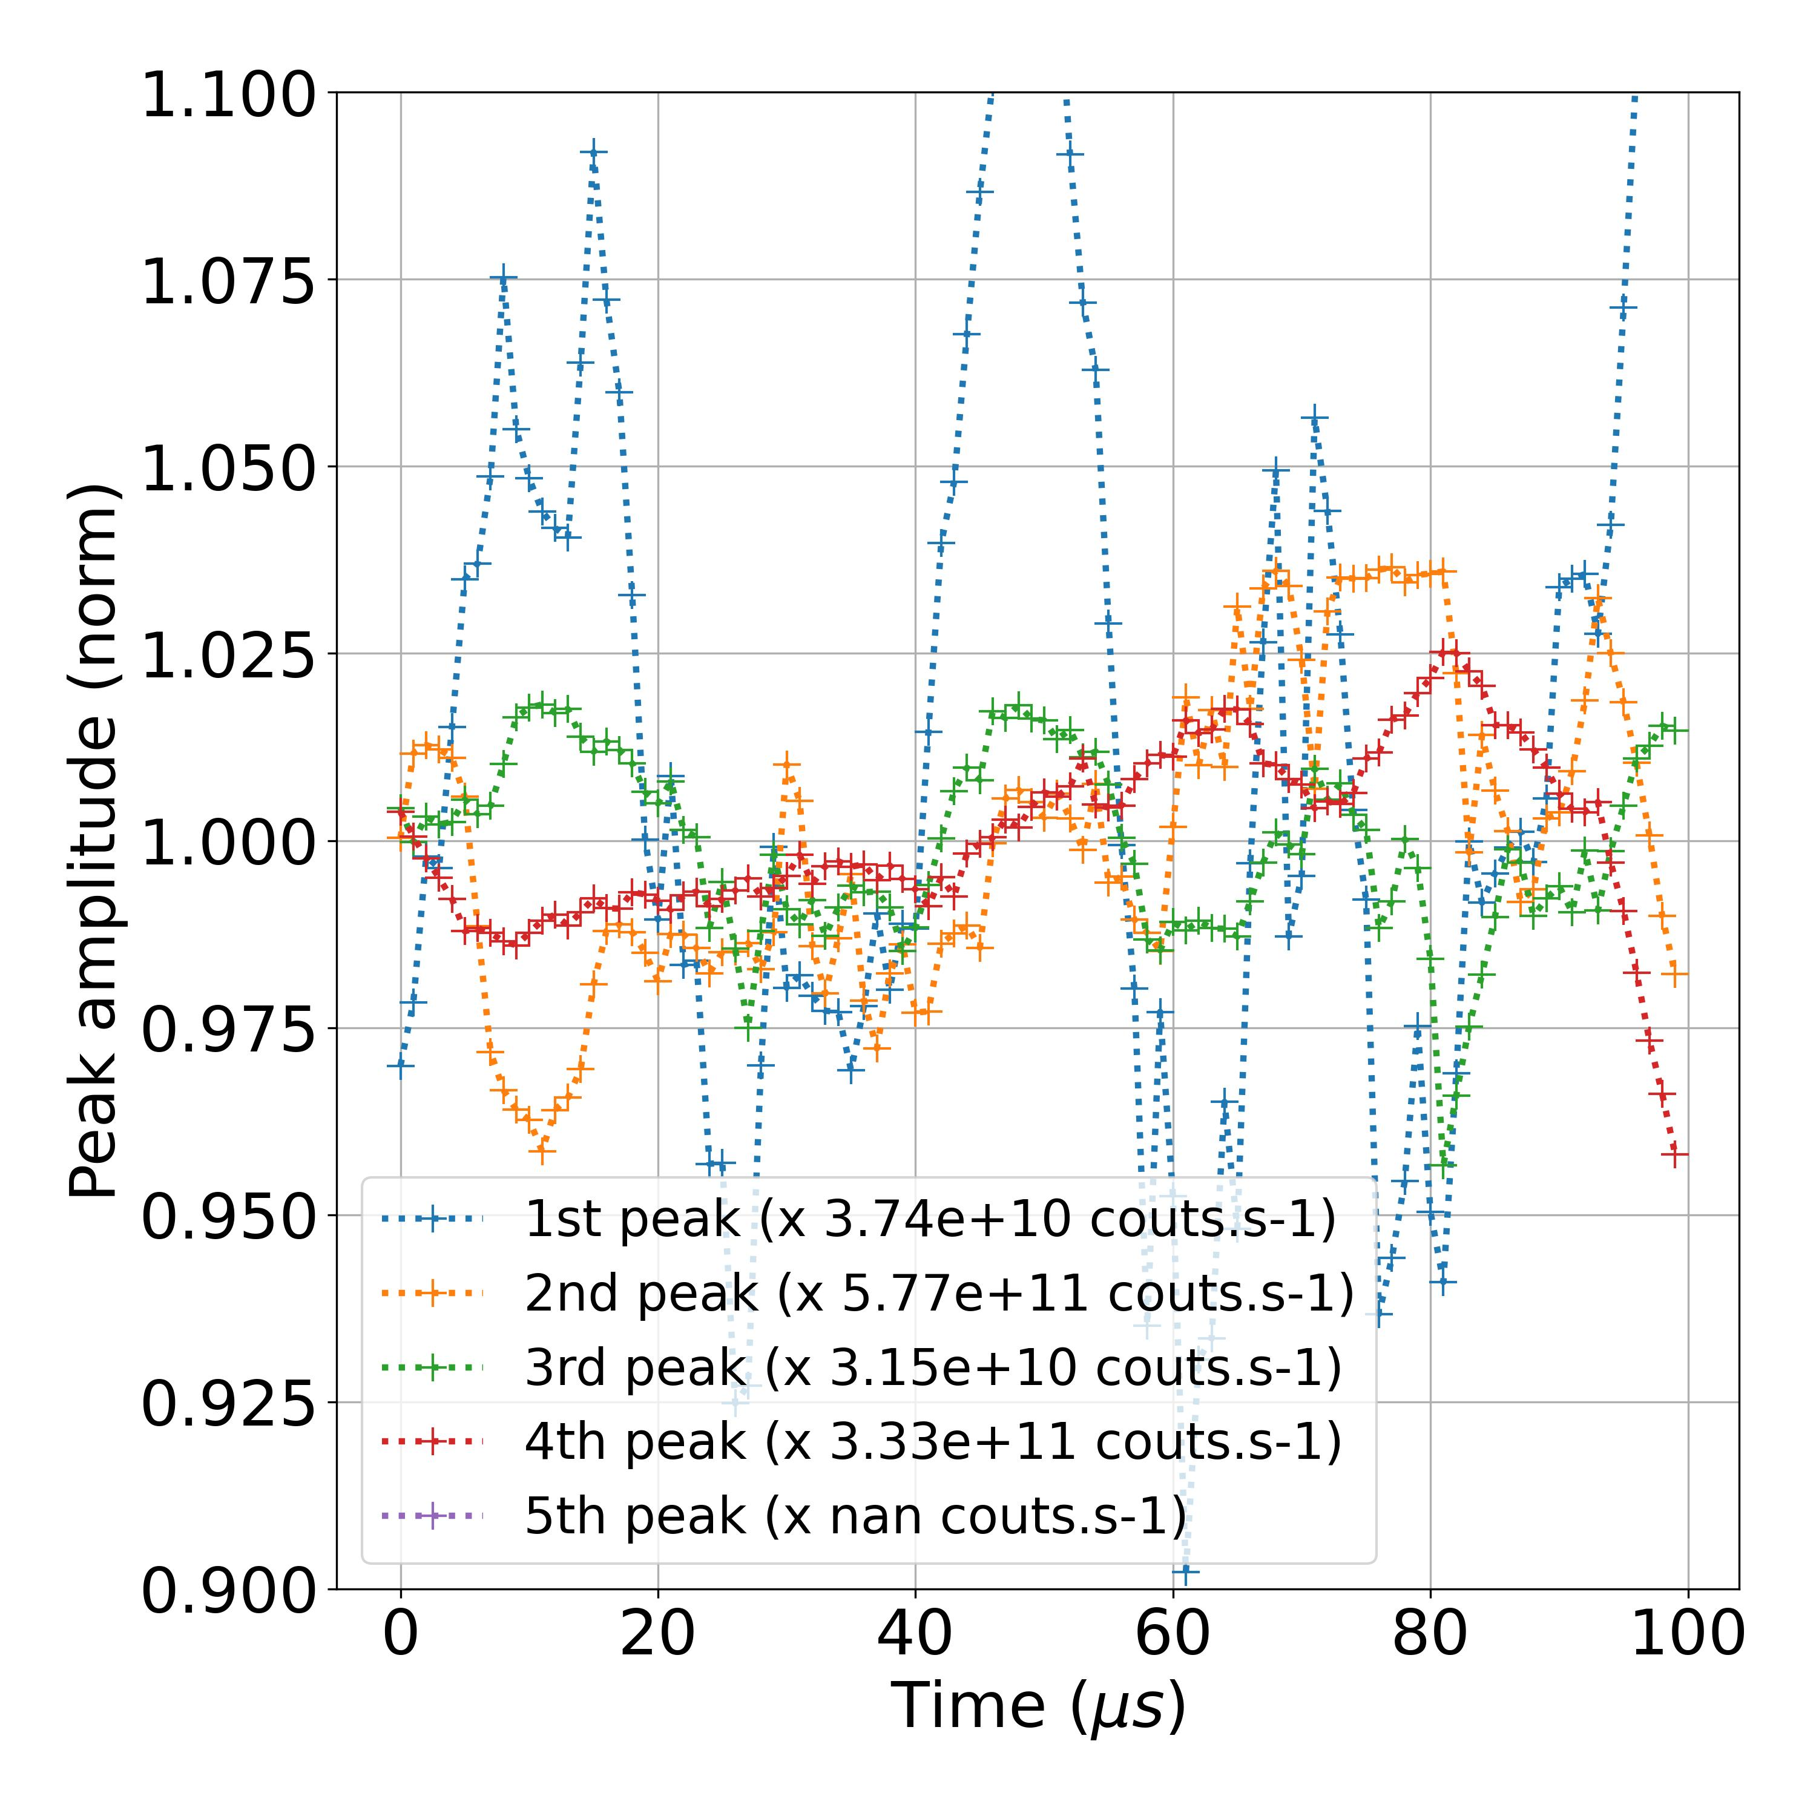
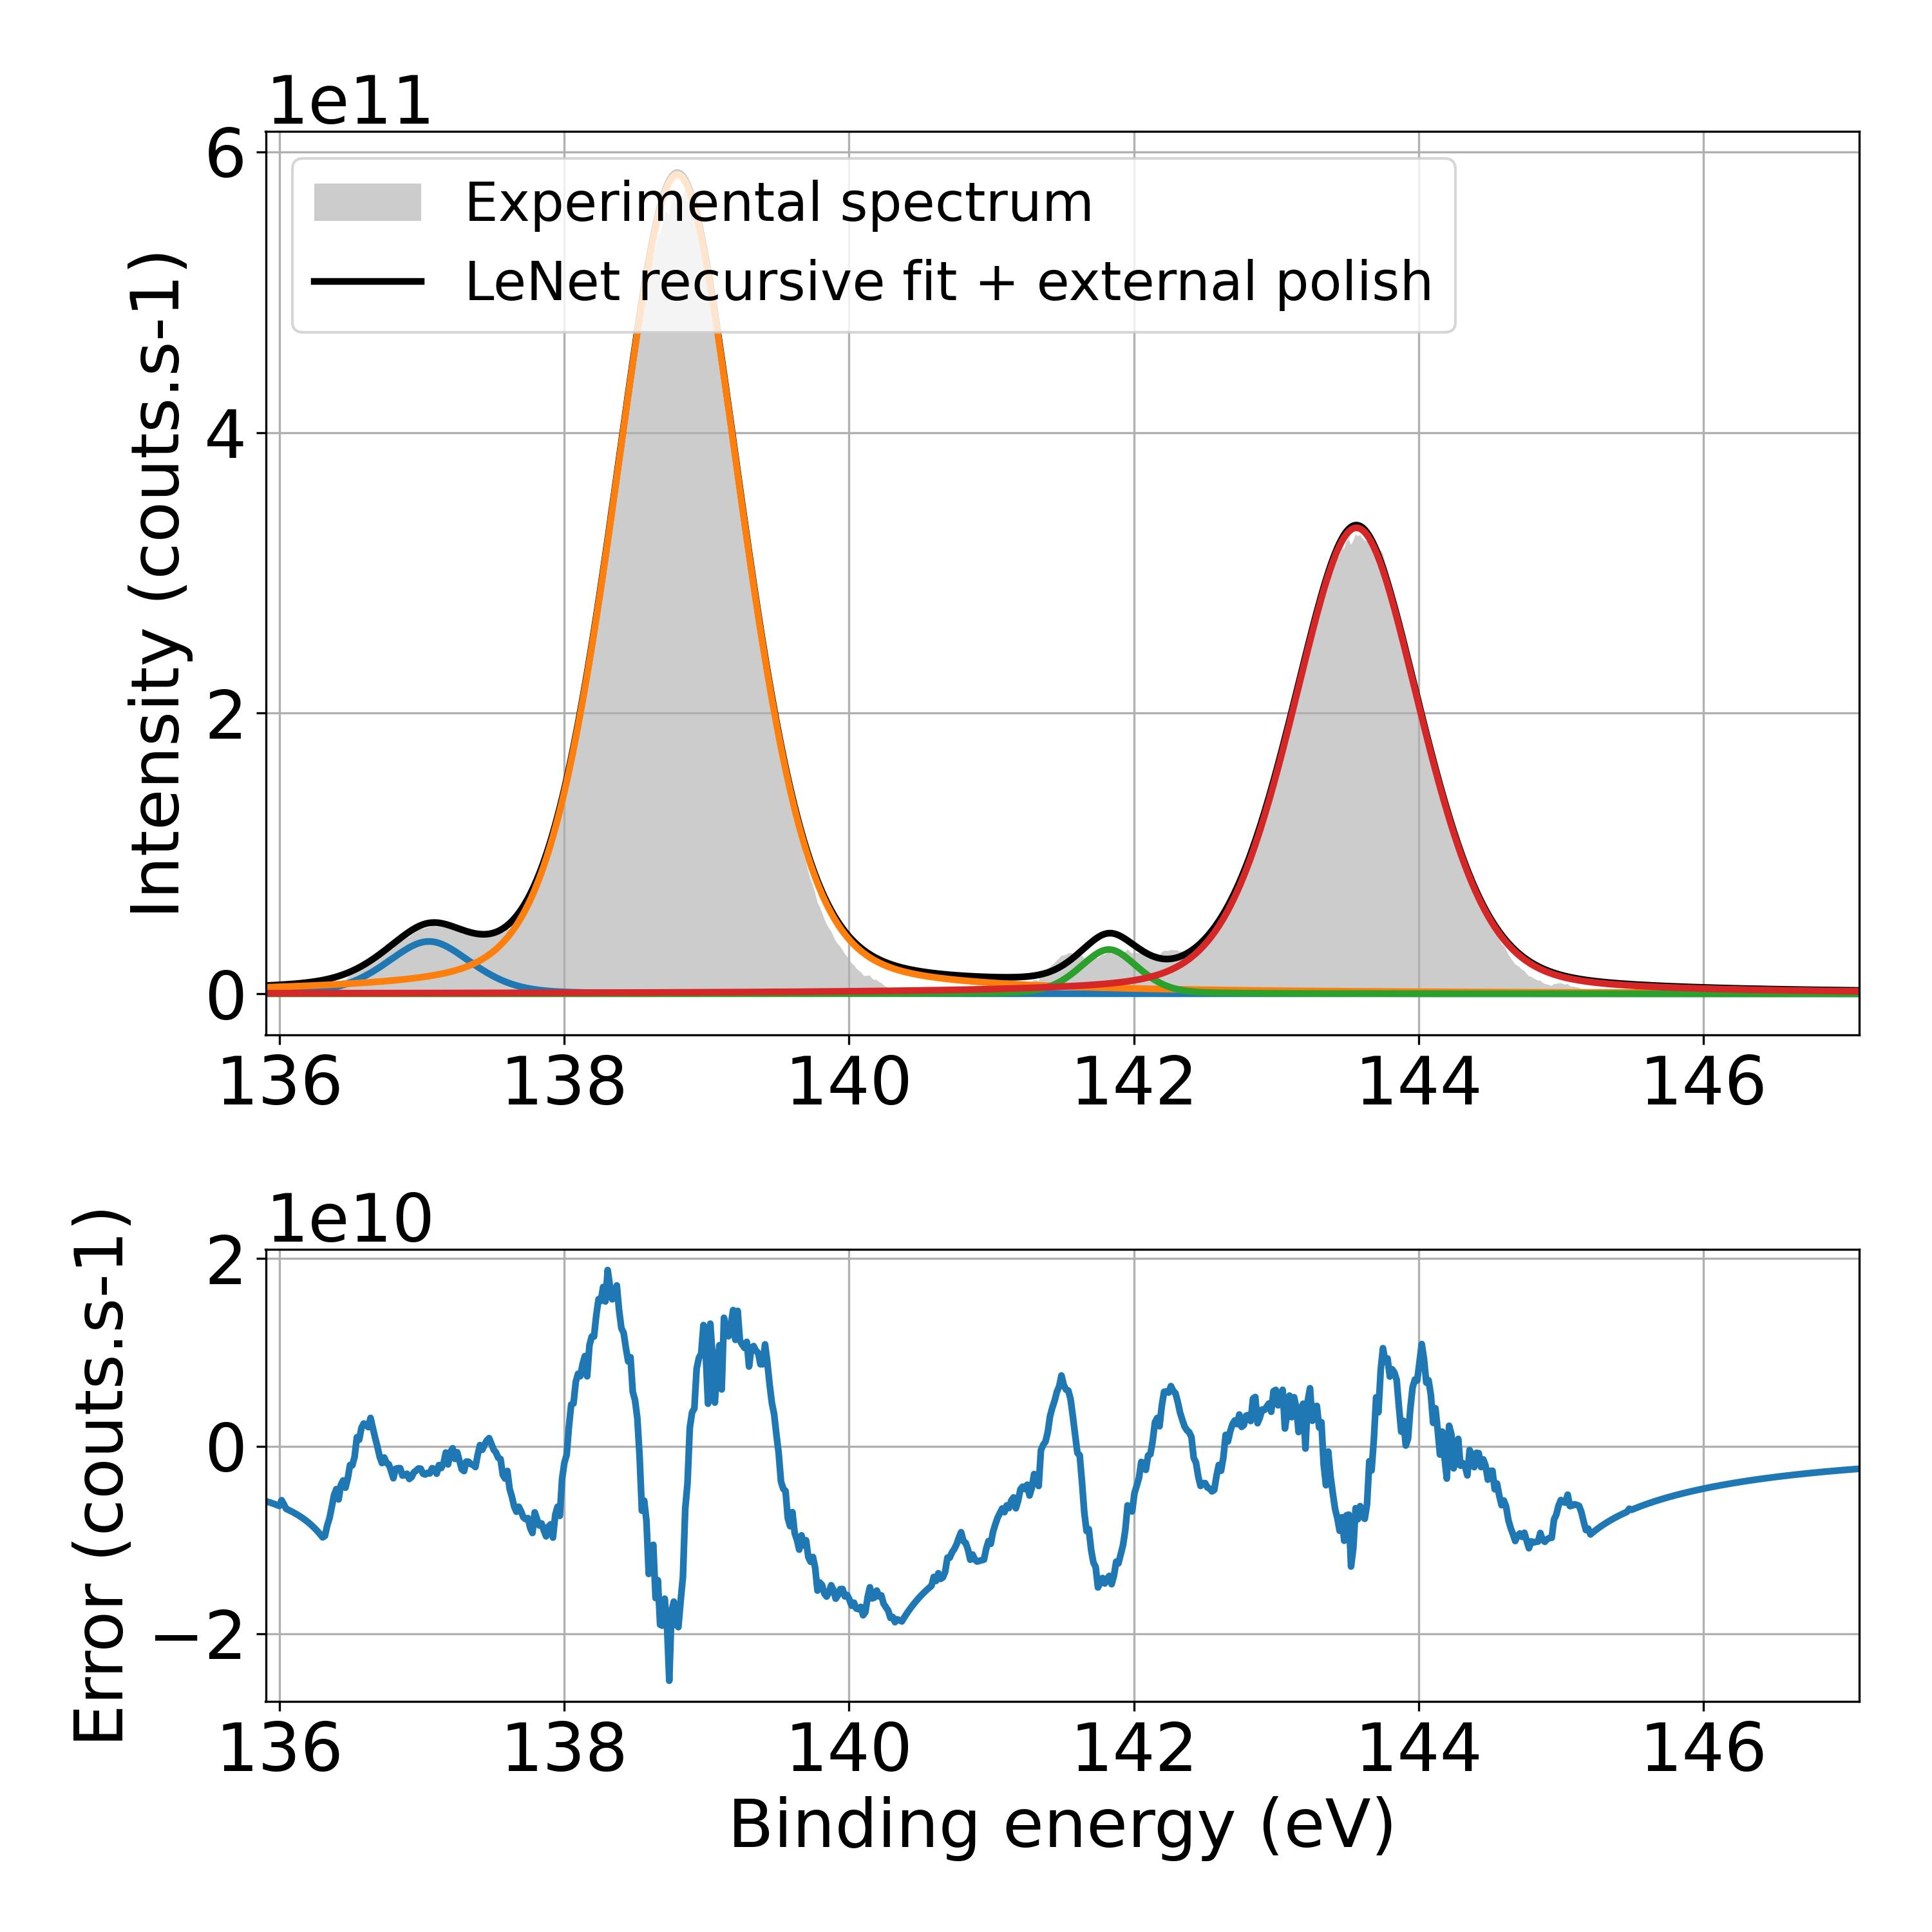
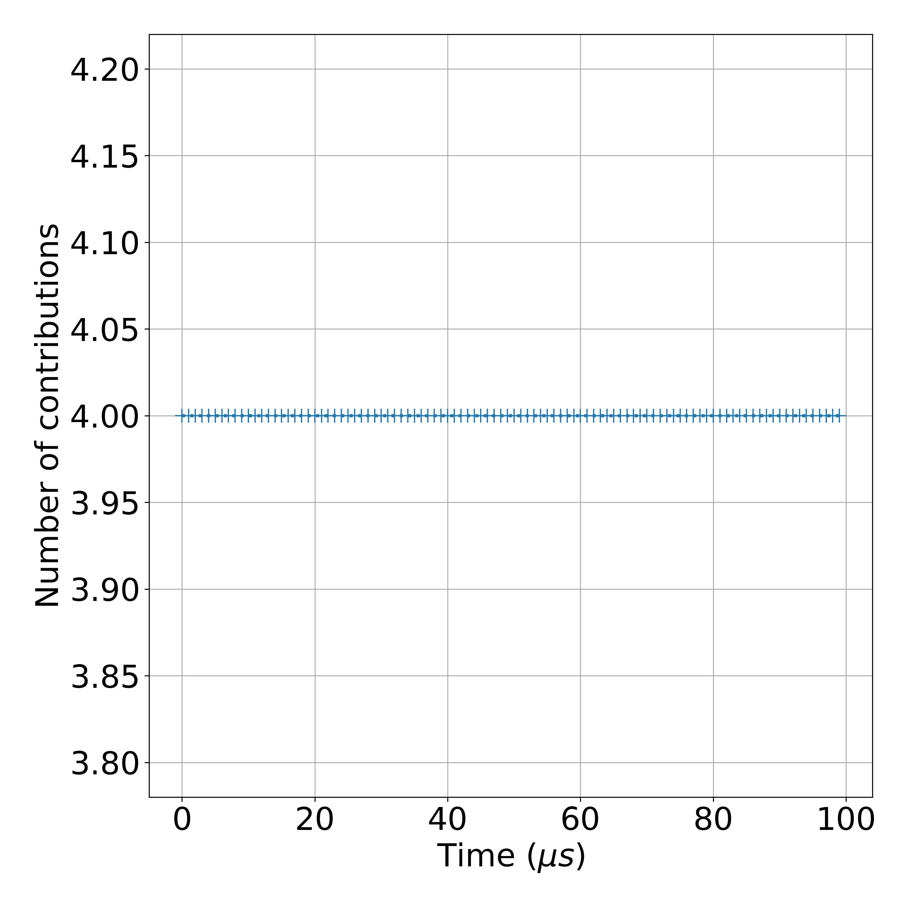
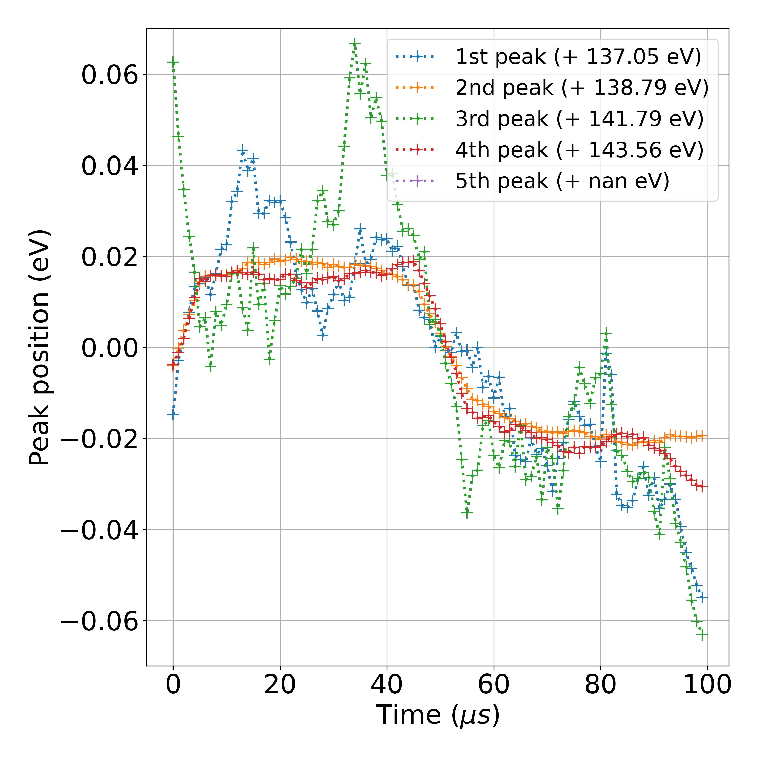
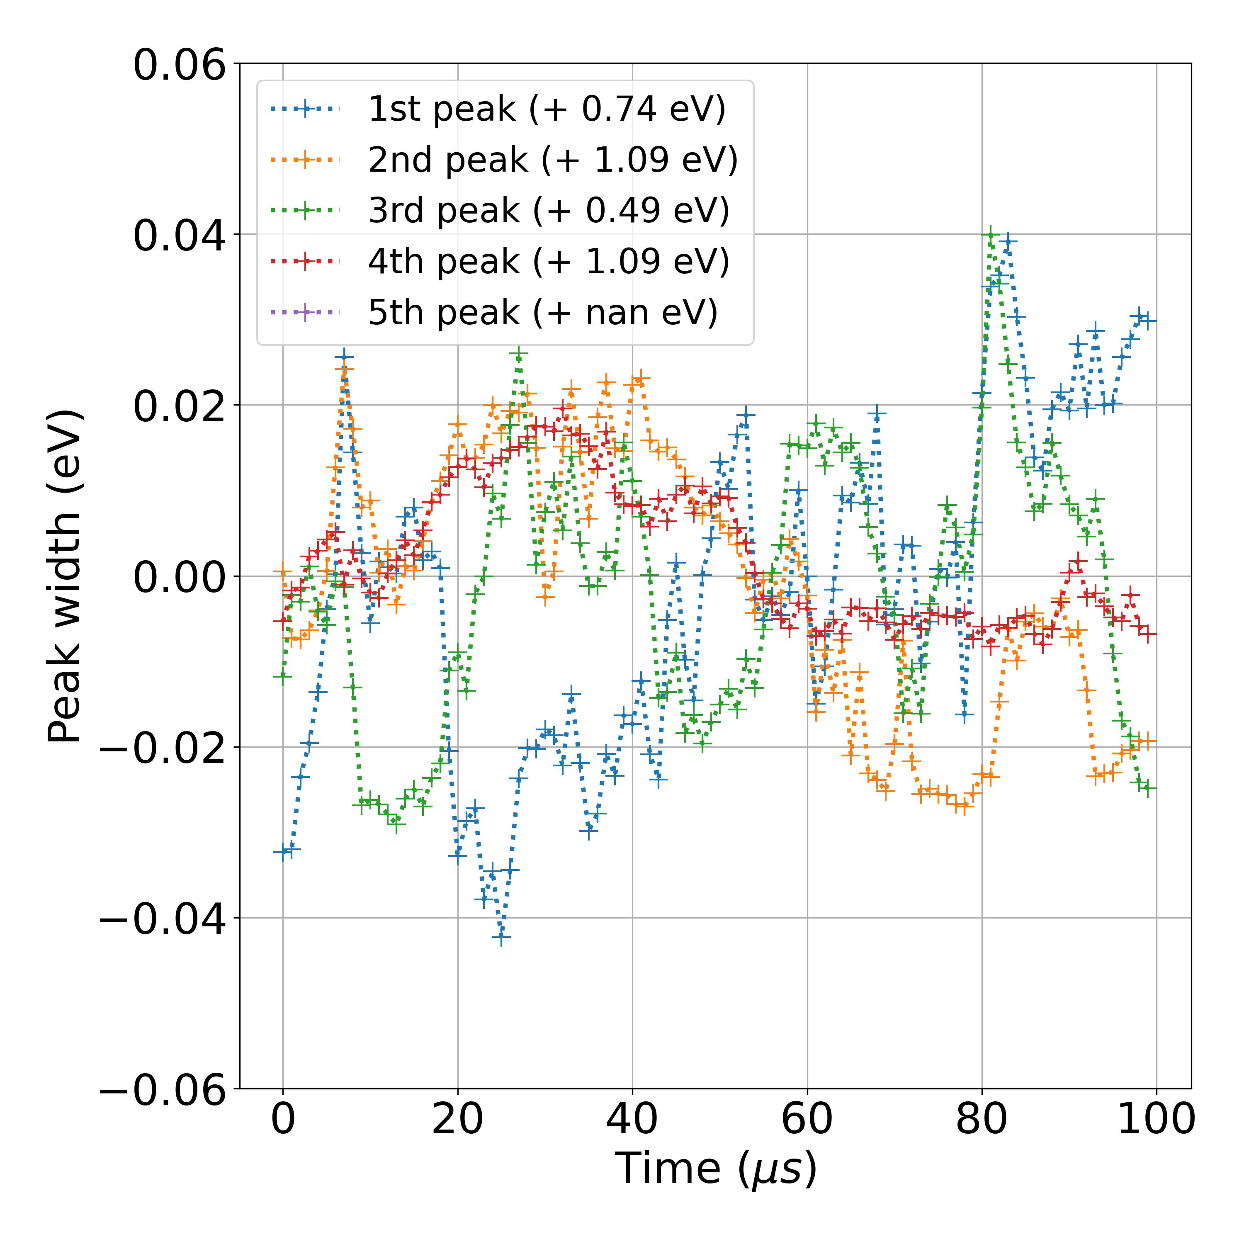
20211125_TR CTF1 Pb 10 mW_0001_2
Measurement number | Measurement Session | Sample | Input power | Core level | File | Comment | Matrix orientiation | Photon energy (eV) | Kinetic energy center (eV) | Energy resolution (eV) | Time resolution (ns) | Studied energy range (indexes) | Time agregation number | Time moving average window (us) | Energy Savitzky-Golay window (meV) | Energy Savitzky-Golay order | Pb 4f 7/2 background range (eV) | Pb 4f 5/2 background range (eV) | I 3d 5/2 background range (eV) | ML training session | ML model | Number of peaks
2 | November 2021 | CTF1 | 10 mW | Pb 4f | 20211125_TR CTF1 Pb 10 mW_0001_2 |  | (E,time) | 750 | 608.5 | 0.016 | 100 | [350,1050] | 10 | 1 | 300 | 3 | [136,140.5] | [140.5,145.5] |  | ML_models_large_database_noisy | LeNet | Auto

Slide 5
20211126_TR CTF1 I3d 1 mW_0001_2
Measurement number | Measurement Session | Sample | Input power | Core level | File | Comment | Matrix orientiation | Photon energy (eV) | Kinetic energy center (eV) | Energy resolution (eV) | Time resolution (ns) | Studied energy range (indexes) | Time agregation number | Time moving average window (us) | Energy Savitzky-Golay window (meV) | Energy Savitzky-Golay order | Pb 4f 7/2 background range (eV) | Pb 4f 5/2 background range (eV) | I 3d 5/2 background range (eV) | ML training session | ML model | Number of peaks
3 | November 2021 | CTF1 | 1 mW | I 3d 5/2 | 20211126_TR CTF1 I3d 1 mW_0001_2 |  | (E,time) | 750 | 129.5 | 0.016 | 100 | [350,1050] | 10 | 1 | 100 | 3 |  |  | [618.5,624] | ML_models_large_database_noisy_v1 | LeNet | Auto

Slide 6
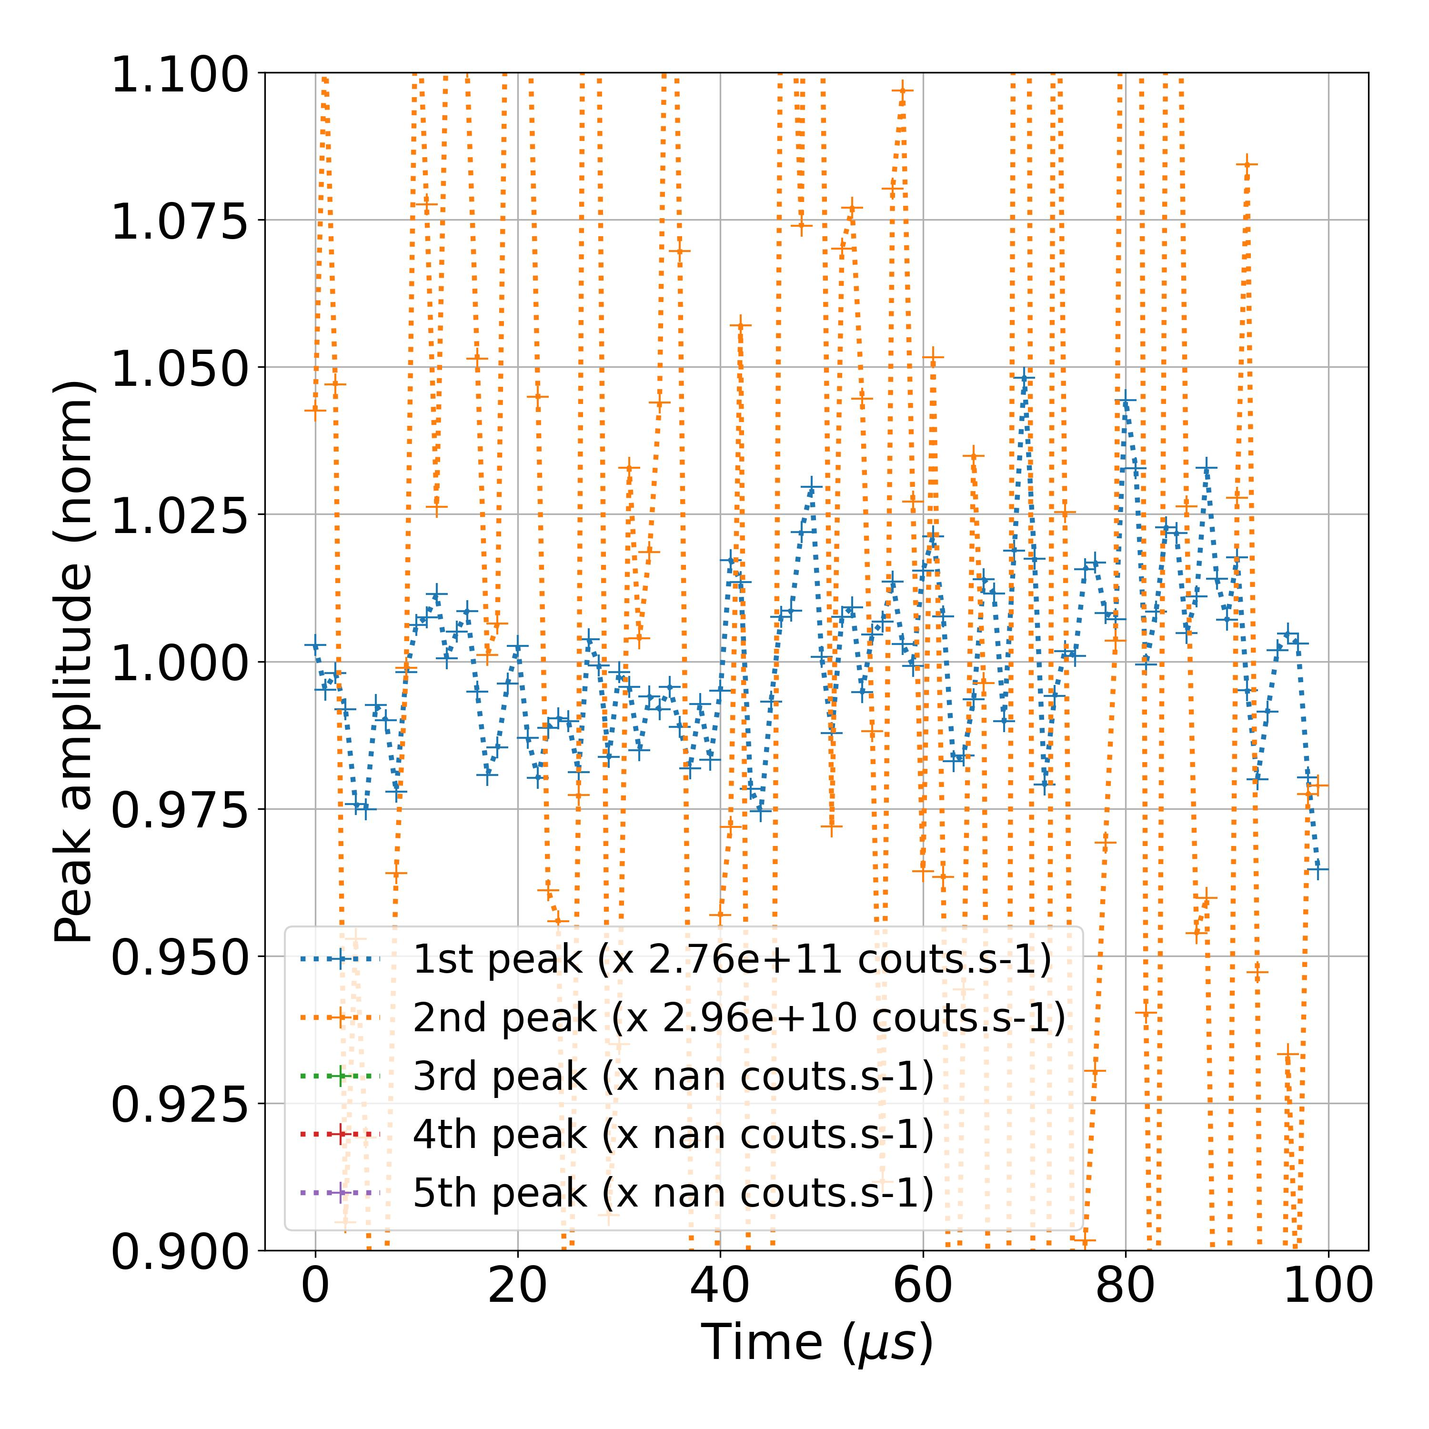
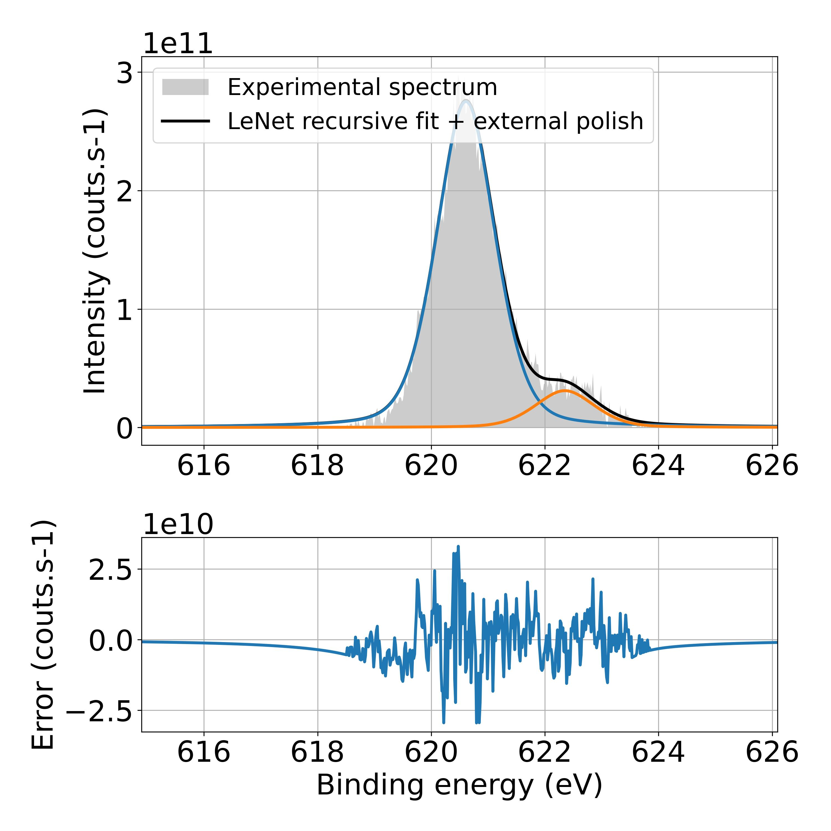
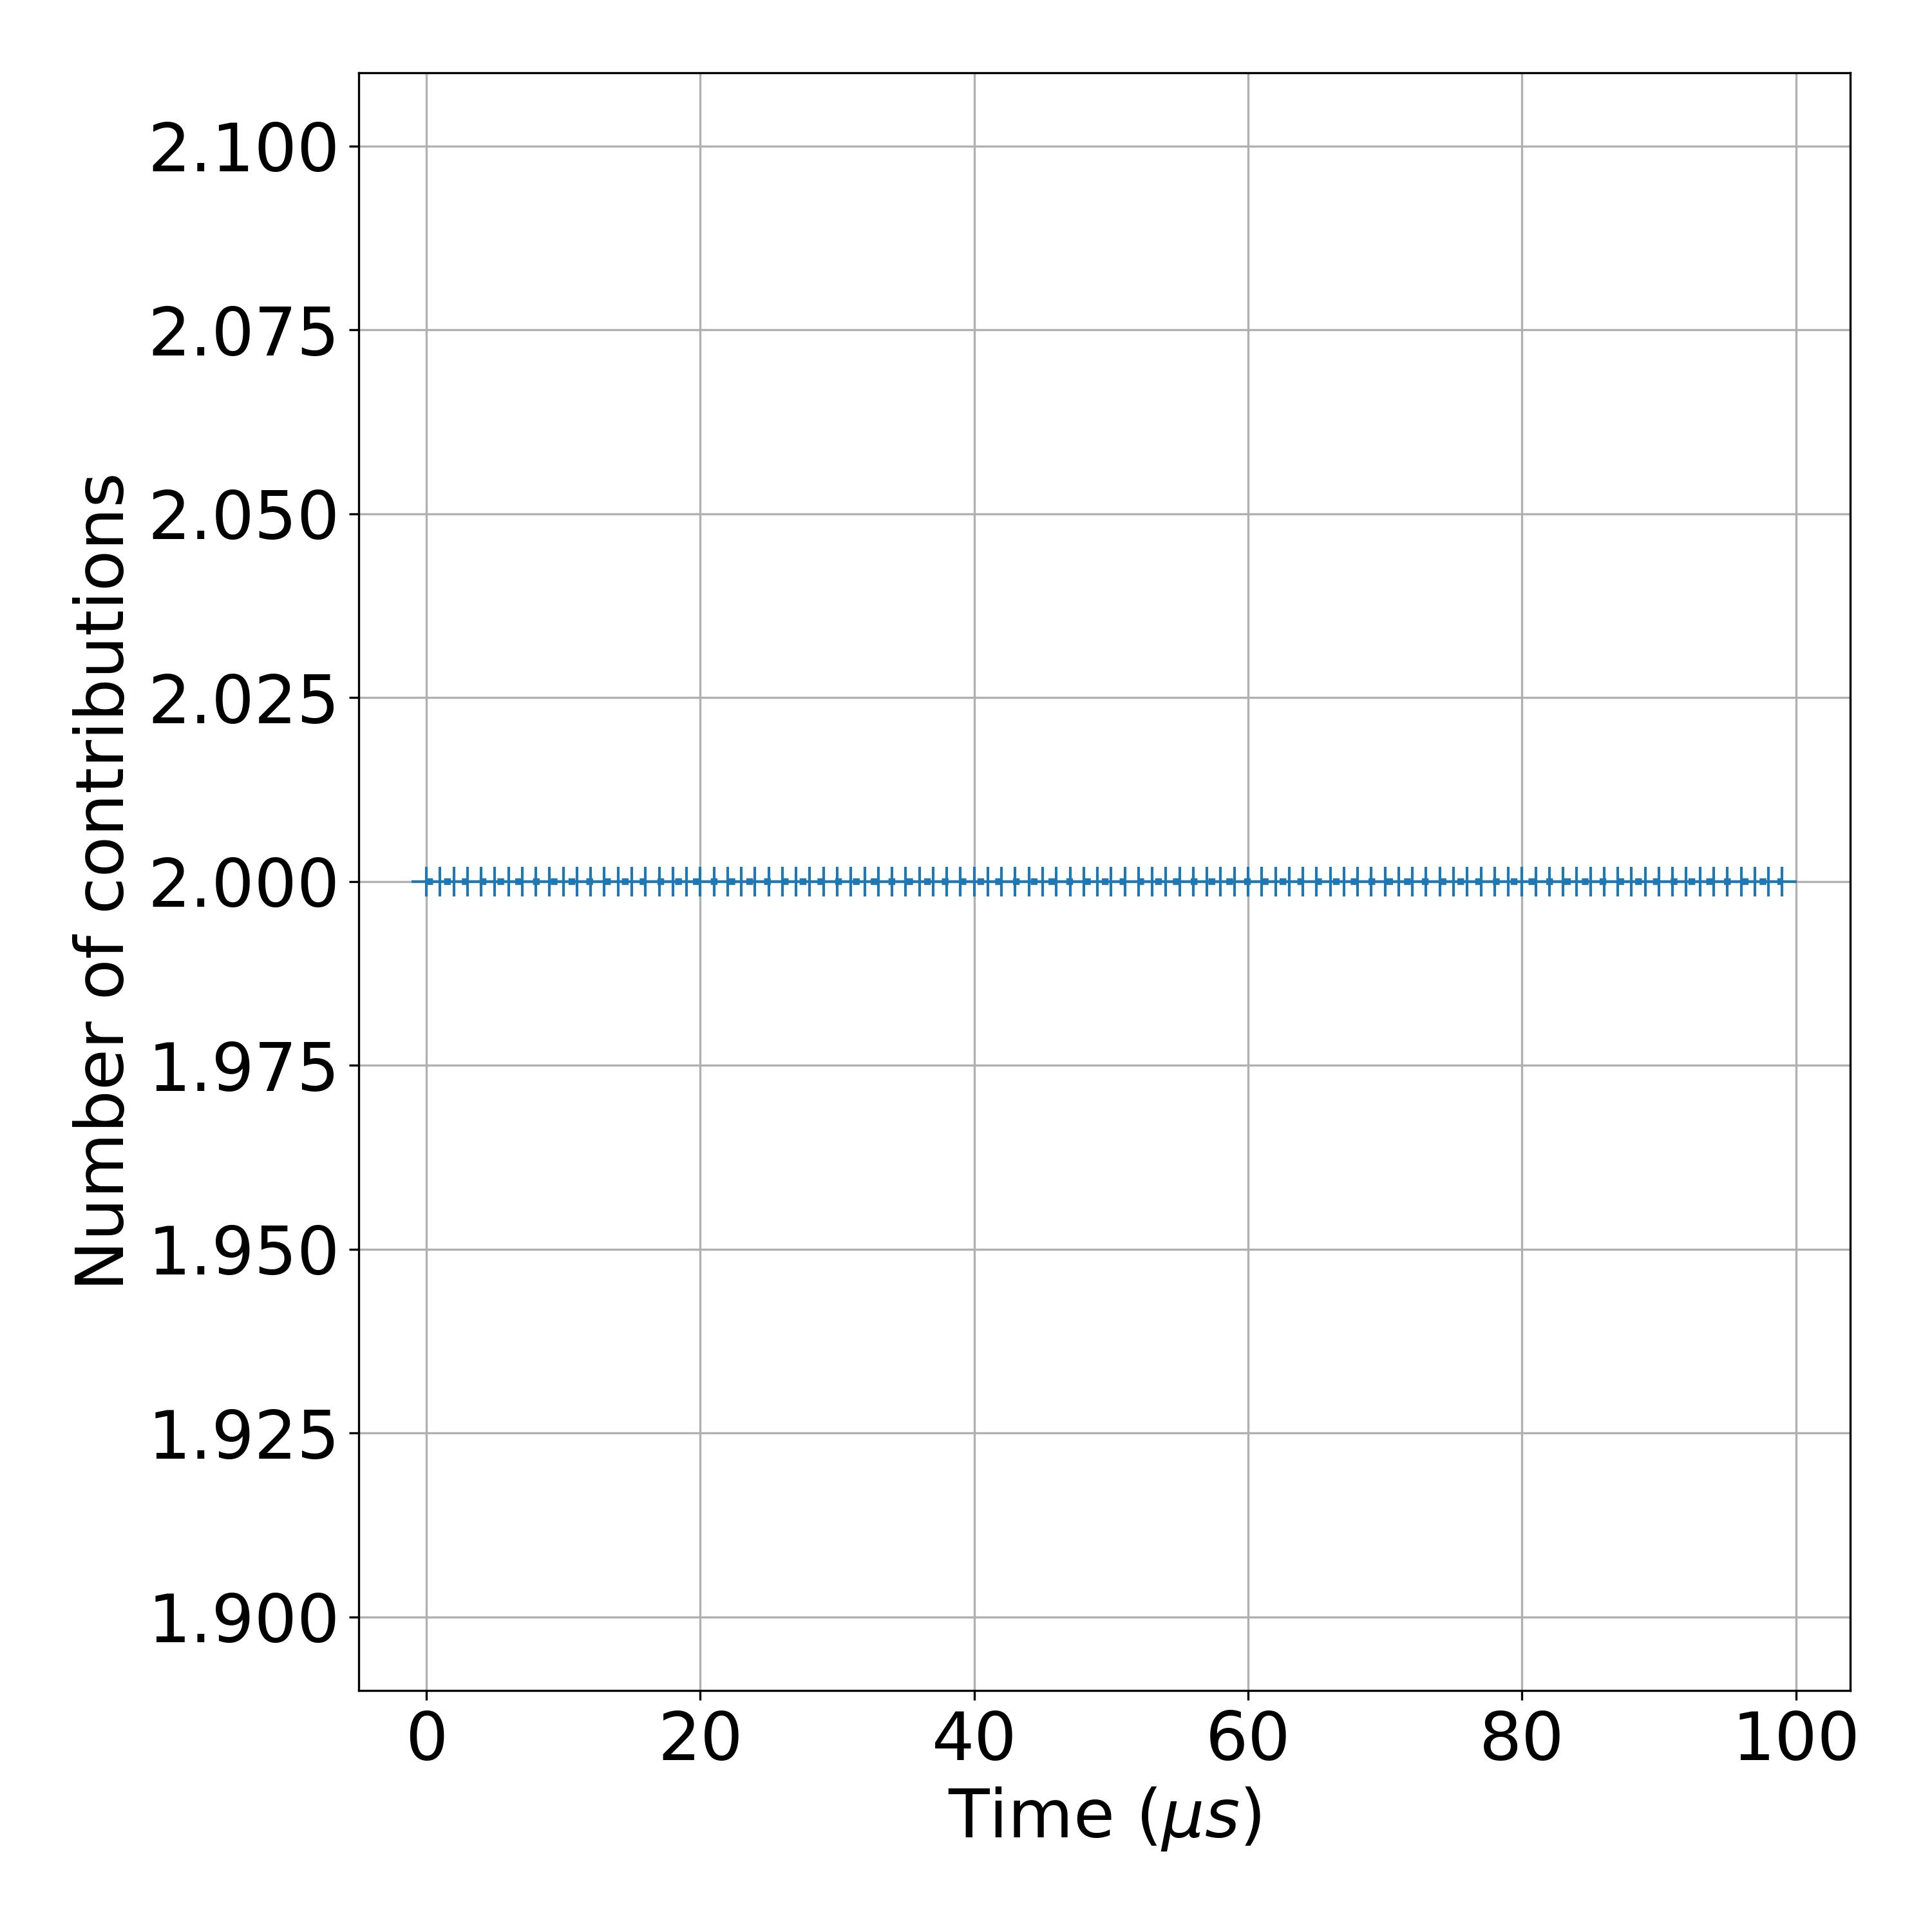
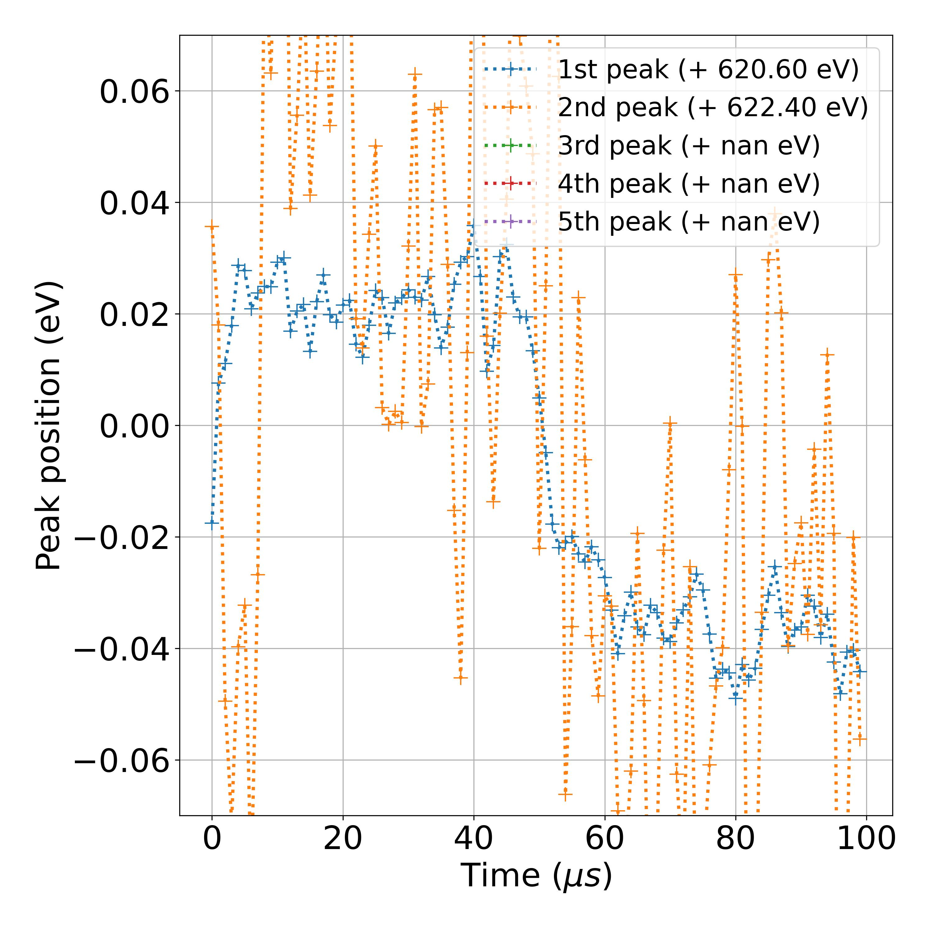
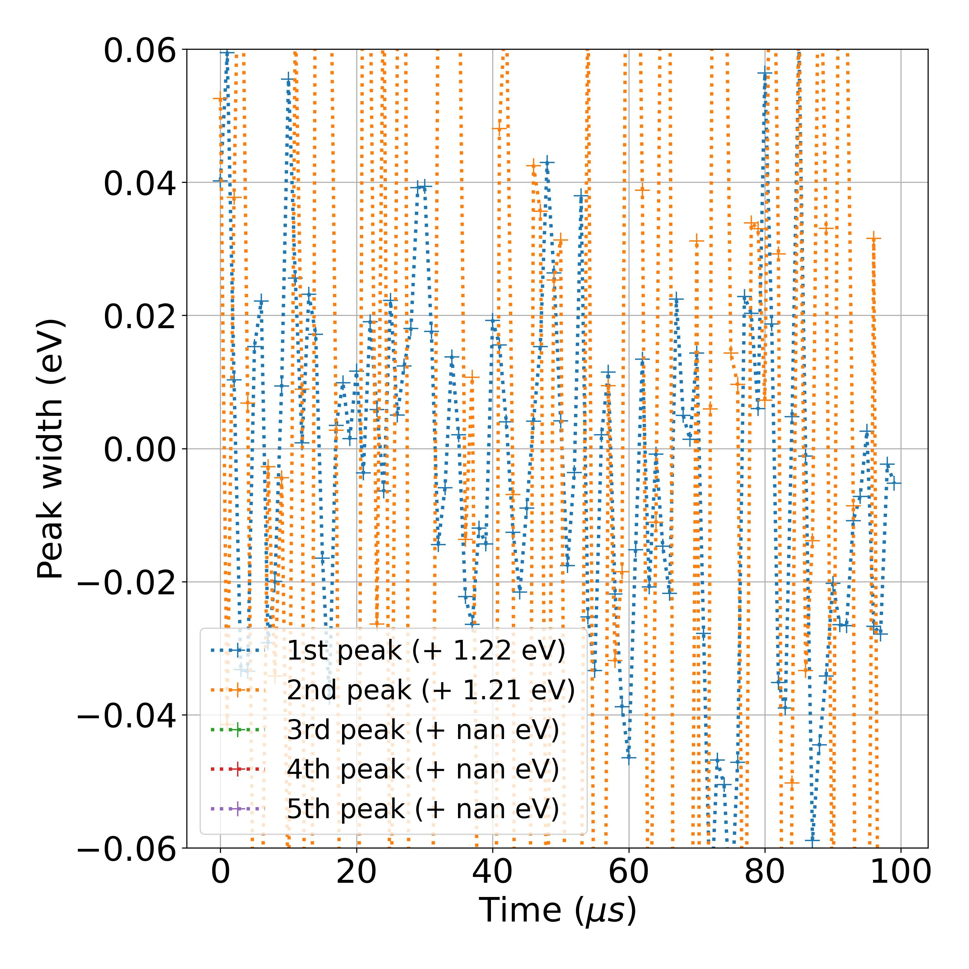
20211125_TR CTF1 I3d 10 mW_0001_2
Measurement number | Measurement Session | Sample | Input power | Core level | File | Comment | Matrix orientiation | Photon energy (eV) | Kinetic energy center (eV) | Energy resolution (eV) | Time resolution (ns) | Studied energy range (indexes) | Time agregation number | Time moving average window (us) | Energy Savitzky-Golay window (meV) | Energy Savitzky-Golay order | Pb 4f 7/2 background range (eV) | Pb 4f 5/2 background range (eV) | I 3d 5/2 background range (eV) | ML training session | ML model | Number of peaks
4 | November 2021 | CTF1 | 10 mW | I 3d 5/2 | 20211125_TR CTF1 I3d 10 mW_0001_2 |  | (E,time) | 750 | 129.5 | 0.016 | 100 | [350,1050] | 10 | 0.2 | 100 | 3 |  |  | [618.5,624] | ML_models_large_database_noisy_v1 | LeNet | Auto

Slide 7
NREL 1
CECI EST UN SOUS-TITRE

Slide 8
NREL1_TRPES_Pb4f_10mW_5_0000_ATR_00000_00000_

Slide 9
NREL1_TRPES_Pb4f_10mW_0000_ATR_00000_00000_

Slide 10
NREL1_TRPES_Pb4f_10mW_0000_ATR_00000_00001_

Slide 11
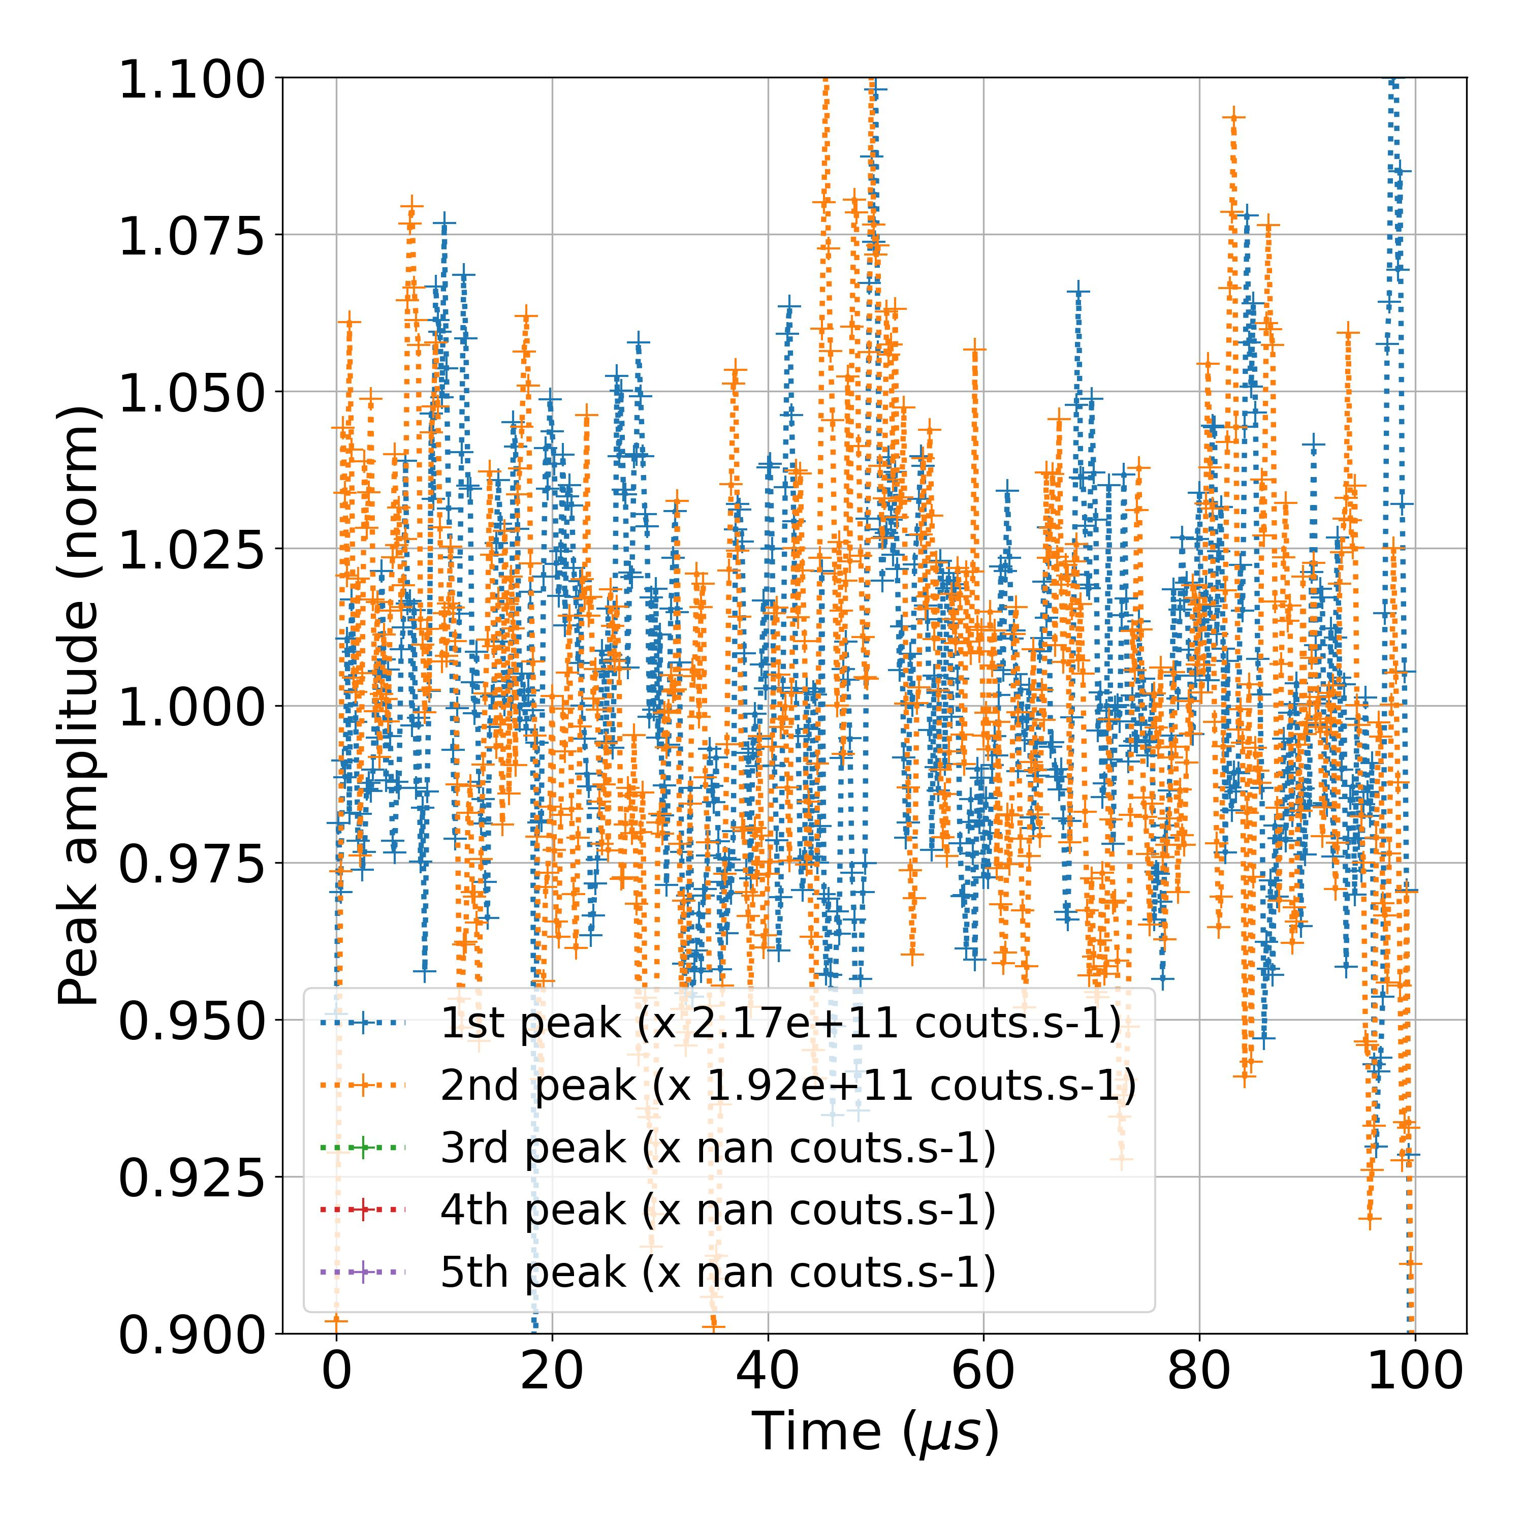
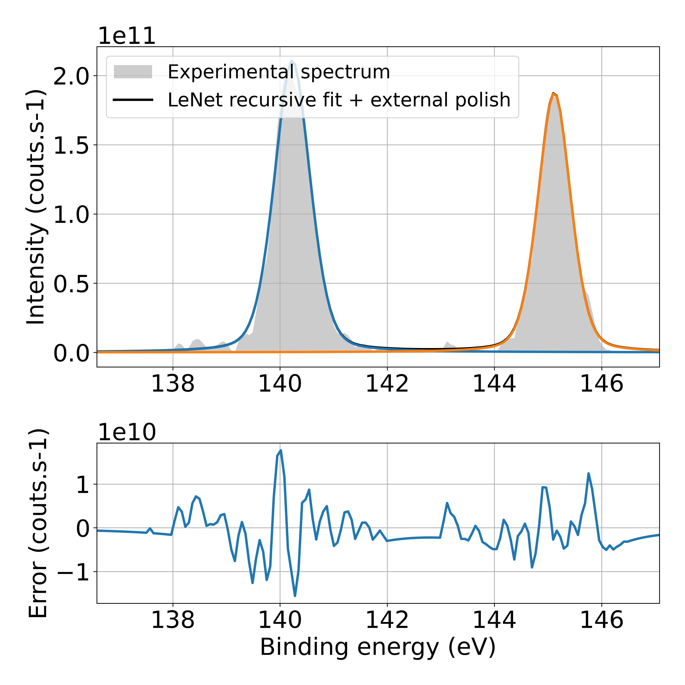
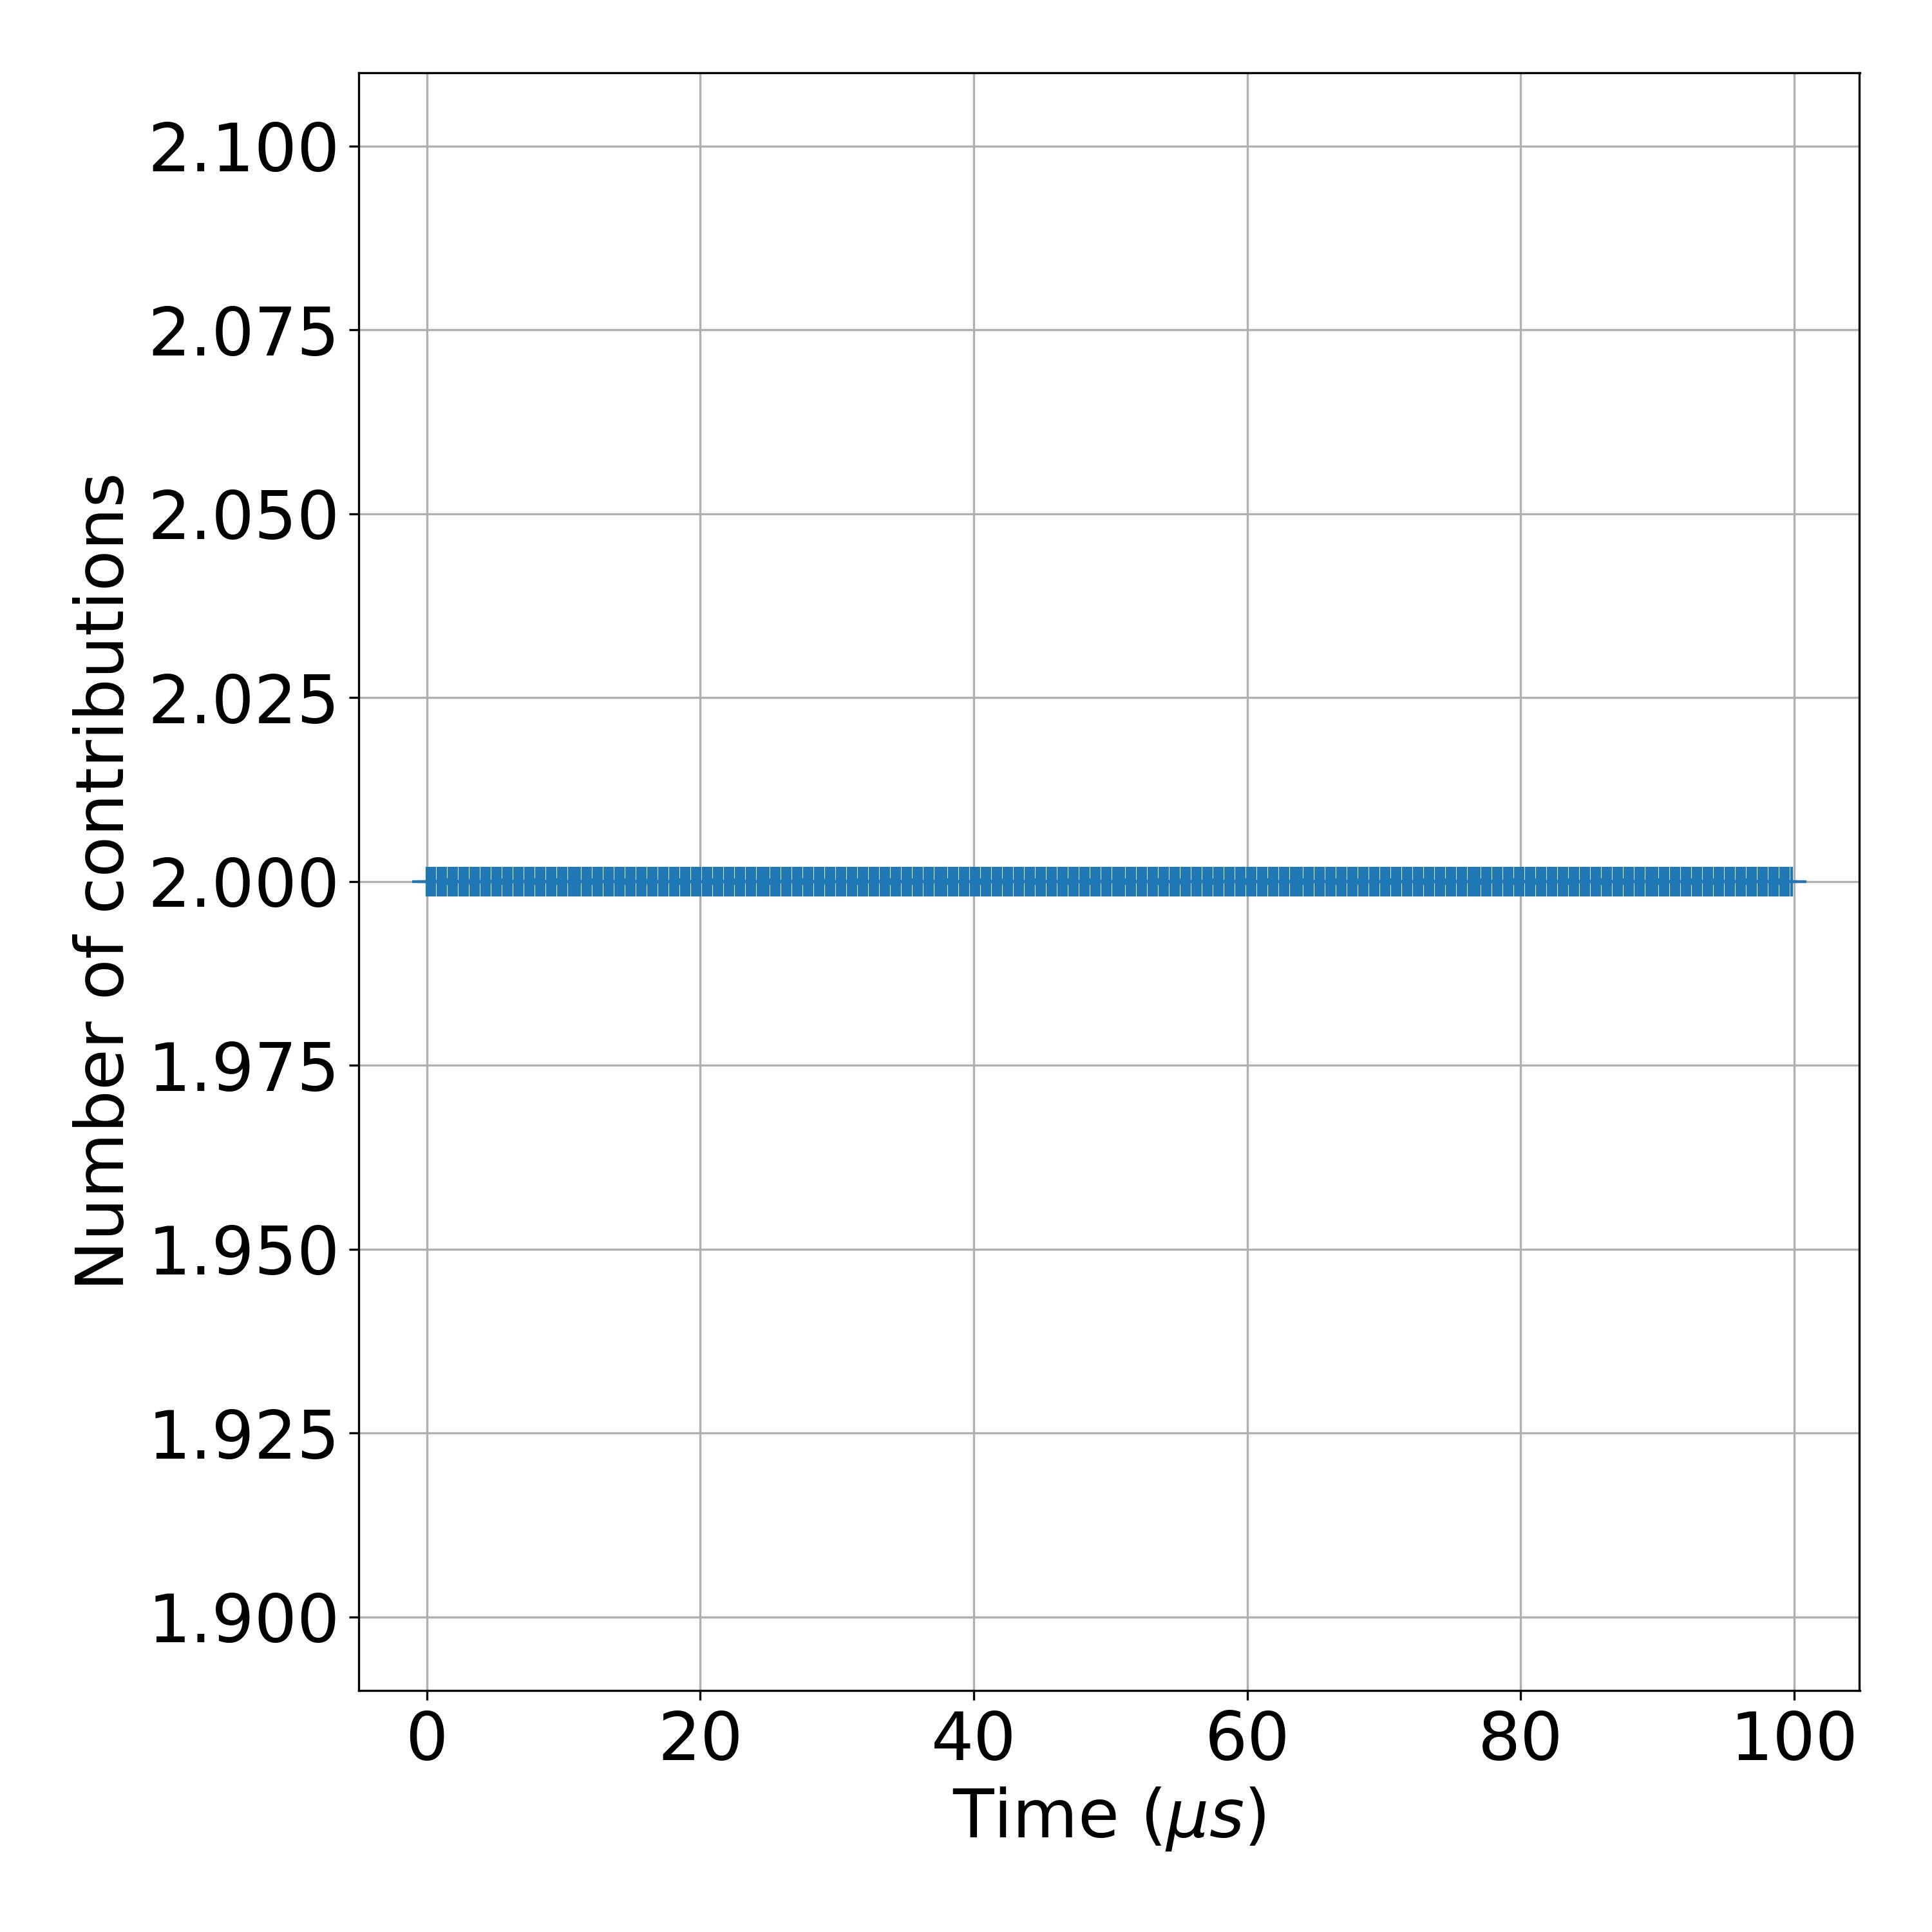
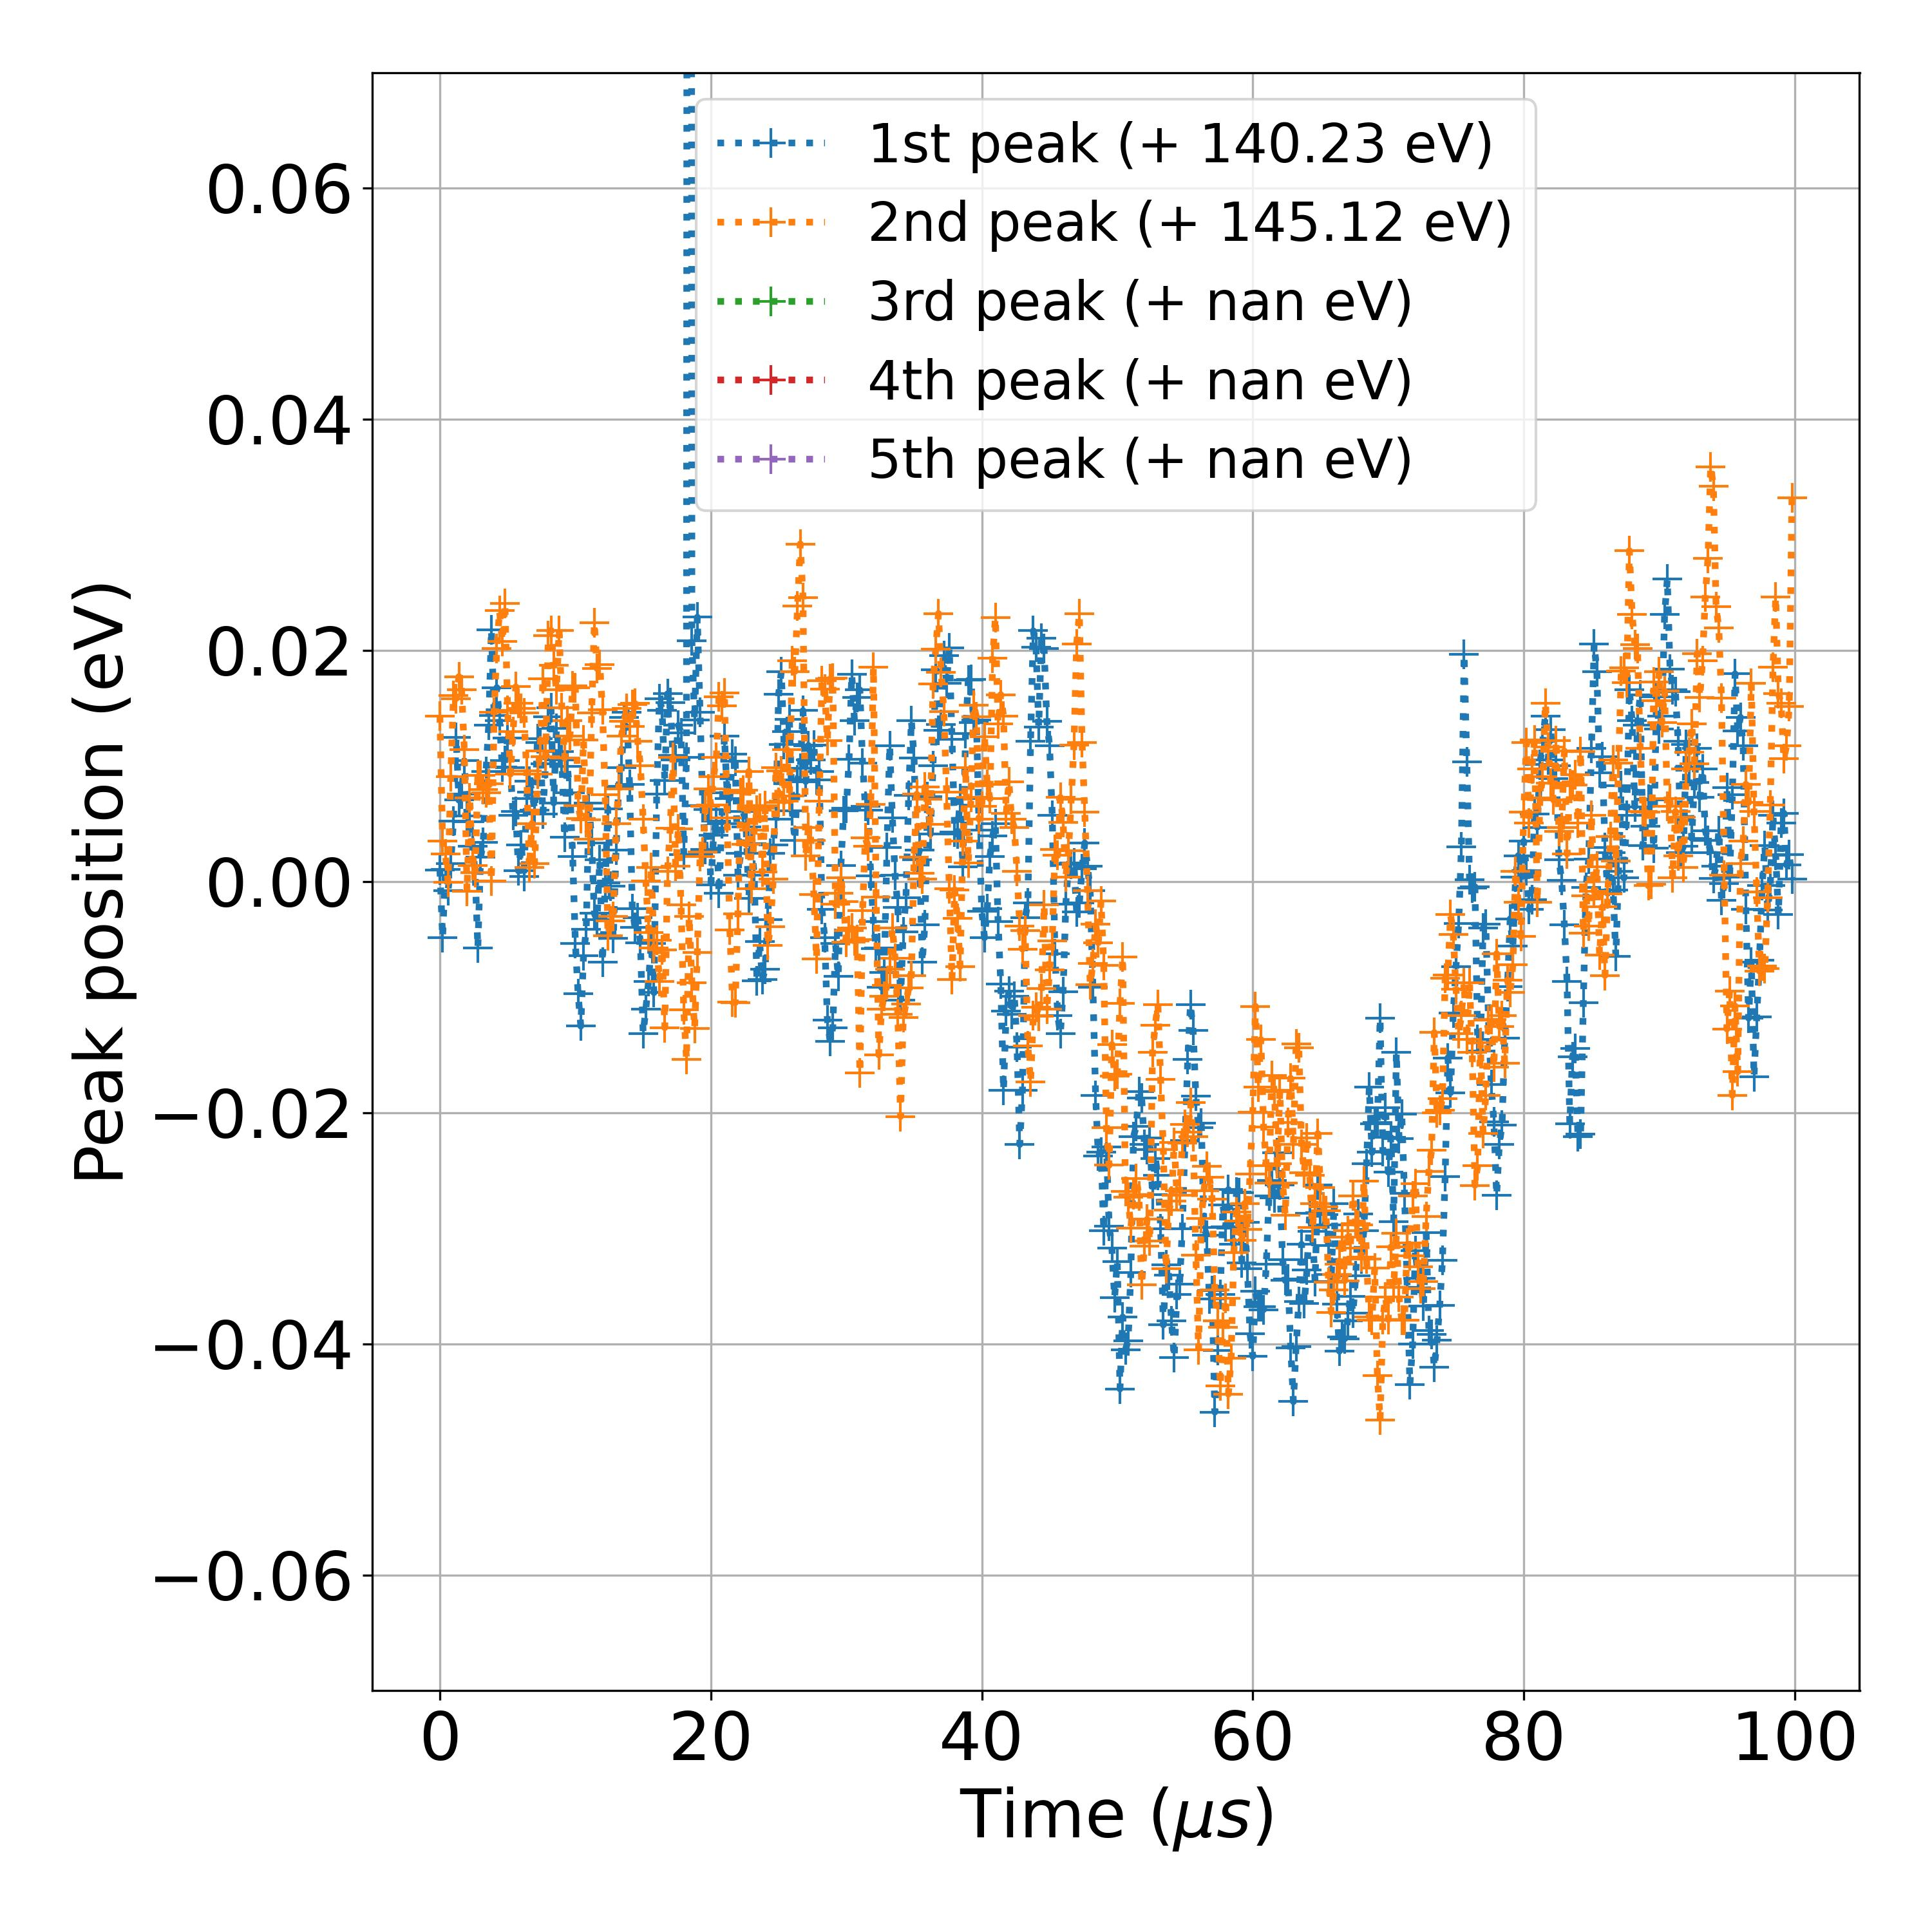
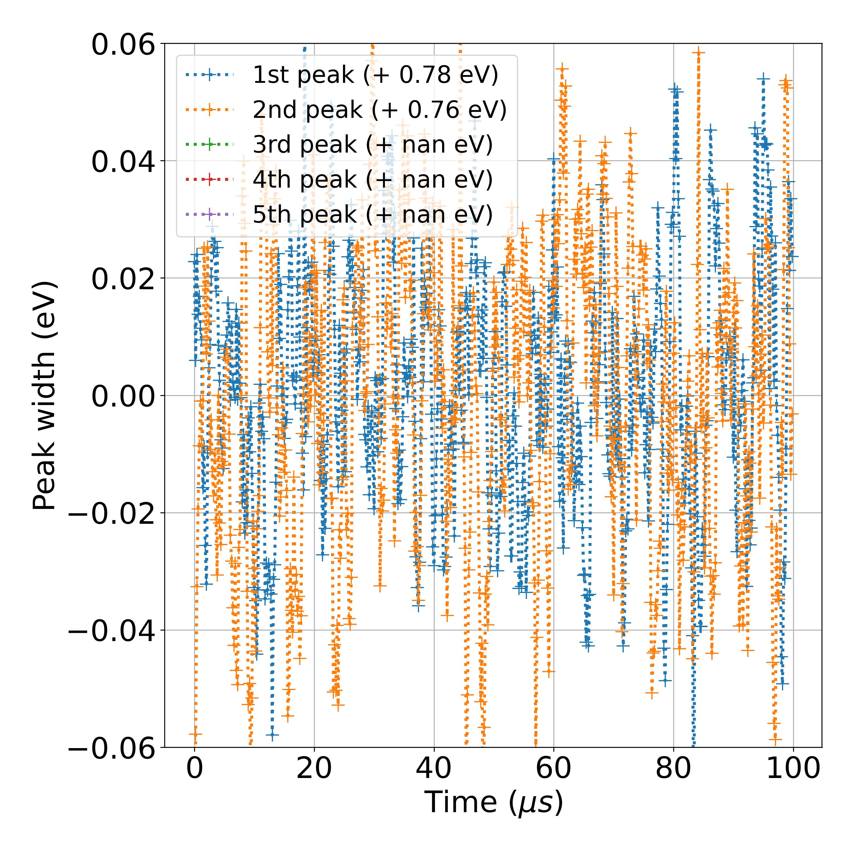
NREL1_TRPES_Pb4F_1mW_0000_ATR_00000_00000_
Measurement number | Measurement Session | Sample | Input power | Core level | File | Comment | Matrix orientiation | Photon energy (eV) | Kinetic energy center (eV) | Energy resolution (eV) | Time resolution (ns) | Studied energy range (indexes) | Time agregation number | Time moving average window (us) | Energy Savitzky-Golay window (meV) | Energy Savitzky-Golay order | Pb 4f 7/2 background range (eV) | Pb 4f 5/2 background range (eV) | I 3d 5/2 background range (eV) | ML training session | ML model | Number of peaks
49 | July 2023 | NREL1 | pulsed 4 mW | Pb 4f | NREL1_TRPES_Pb4F_1mW_0000_ATR_00000_00000_ |  | (time,E) | 750 | 608.5 | 0.0658 | 20 | [90,250] | 10 | 0.1 | 400 | 3 | [137.5,142] | [143,146.5] |  | ML_models_large_database_noisy_v1 | LeNet | 2

Slide 12
NREL1_TRPES_Pb4F_1mW_0000_ATR_00000_00001_

Slide 13
NREL1_TRPES_Pb4F_1mW_0000_ATR_00000_00002_

Slide 14
NREL1_TRPES_Pb4F_1mW_0000_ATR_00000_00003_

Slide 15
NREL1_TRPES_Pb4F_1mW_0000_ATR_00000_00004_

Slide 16
NREL1_TRPES_Pb4F_1mW_0000_ATR_00000_00005_

Slide 17
NREL1_TRPES_I3d_1mW__0000_ATR_00000_00000_

Slide 18
NREL1_TRPES_I3d_1mW__0000_ATR_00000_00001_

Slide 19
NREL1_TRPES_I3d_1mW__0000_ATR_00000_00002_

Slide 20
NREL1_TRPES_I3d_1mW_0000_ATR_00000_00000_

Slide 21
NREL1_TRPES_Pb4f_40mW_0000_ATR_00000_00000_

Slide 22
NREL1_TRPES_Pb4f_40mW_0001_ATR_00000_00000_

Slide 23
NREL1_TRPES_Pb4f_40mW_0002_ATR_00000_00000_

Slide 24
NREL1_TRPES_Pb4f_40mW_0003_ATR_00000_00000_

Slide 25
NREL1_TRPES_I3d_40mW_0000_ATR_00000_00000_

Slide 26
NREL1_TRPES_I3d_40mW_0001_ATR_00000_00000_

Slide 27
NREL1_TRPES_I3d_40mW_0002_ATR_00000_00000_

Slide 28
NREL1_TRPES_I3d_40mW_0003_ATR_00000_00000_

Slide 29
NREL 3
CECI EST UN SOUS-TITRE

Slide 30
NREL3_TRPES_Pb4f_4mW_0001_ATR_00000_00000_

Slide 31
NREL3_TRPES_Pb4f_4mW_0002_ATR_00000_00000_

Slide 32
NREL3_TRPES_I3d5-2_4mW_0000_ATR_00000_00000_

Slide 33
NREL3_TRPES_I3d5-2_4mW_0001_ATR_00000_00000_

Slide 34
NREL3_TRPES_Pb4f_40mW_0000_ATR_00000_00000_

Slide 35
NREL3_TRPES_Pb4f_40mW_0001_ATR_00000_00000_

Slide 36
NREL3_TRPES_Pb4f_40mW_0002_ATR_00000_00000_

Slide 37
NREL3_TRPES_Pb4f_40mW_0003_ATR_00000_00000_

Slide 38
NREL3_TRPES_Pb4f_40mW_0004_ATR_00000_00000_

Slide 39
NREL3_TRPES_Pb4f_40mW_0005_ATR_00000_00000_

Slide 40
NREL3_TRPES_Pb4f_40mW_0006_ATR_00000_00000_

Slide 41
NREL3_TRPES_I3d5_40mW_0000_ATR_00000_00000_

